Slide 1
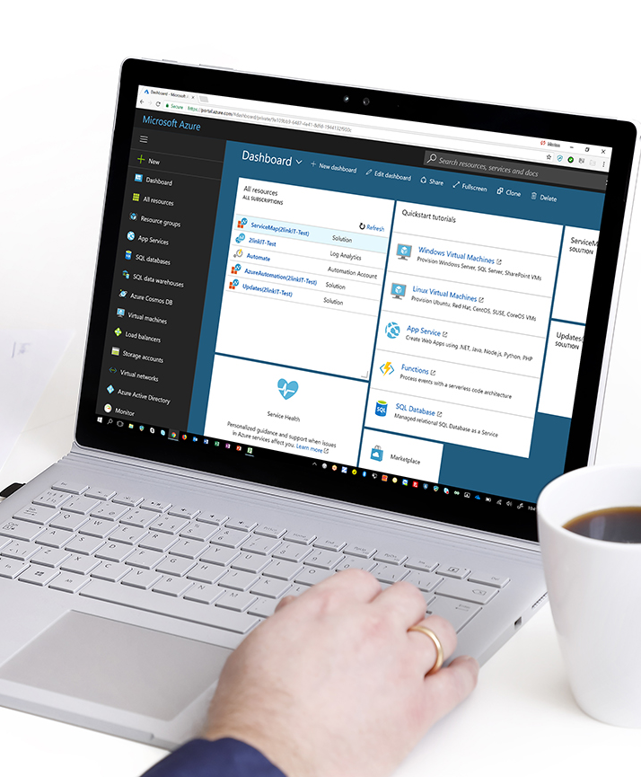



Client Insight using Next-Generation Azure Log Capabilities
Morten Knudsen
My LinkedIn Profile
(connect)

Slide 2
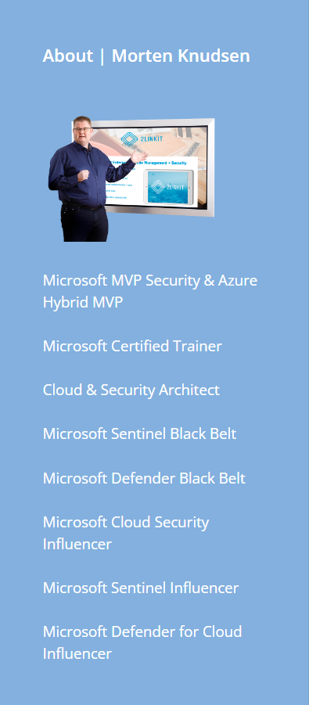
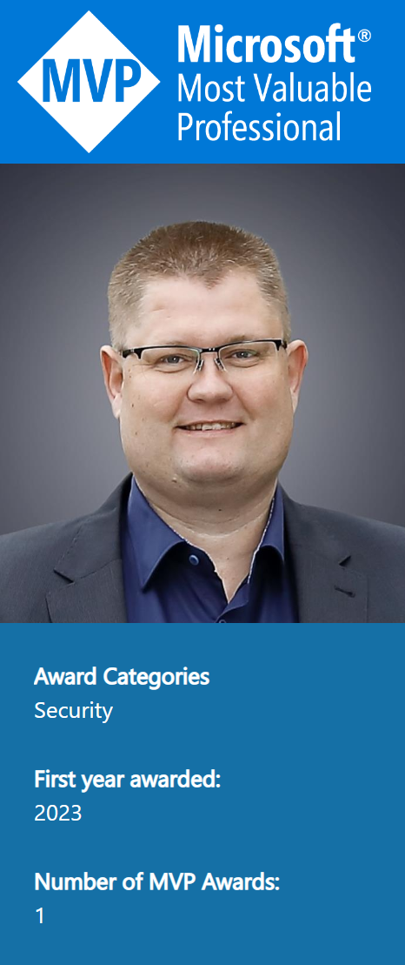

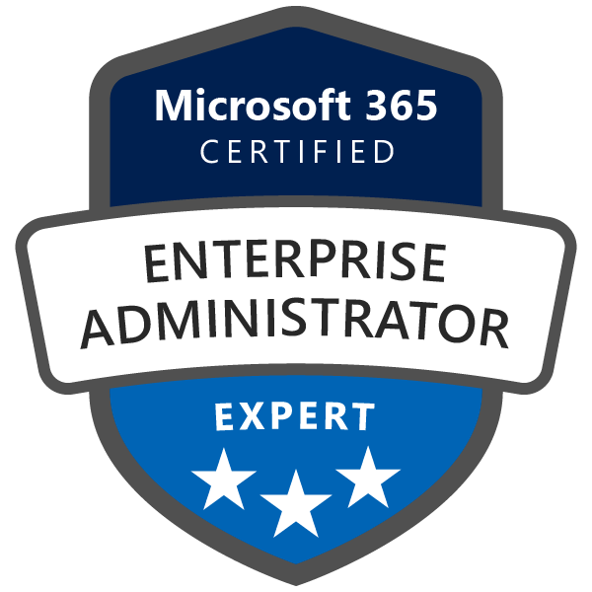







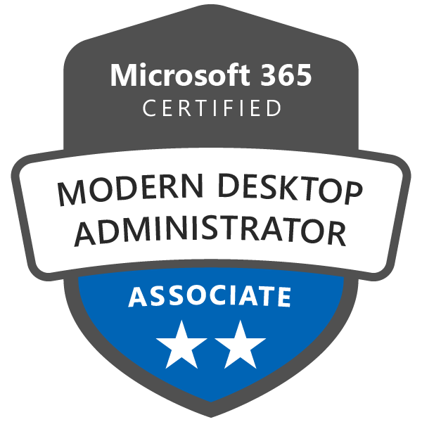



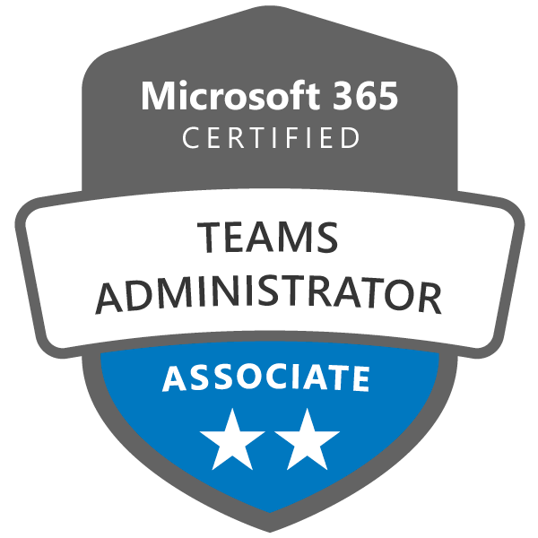

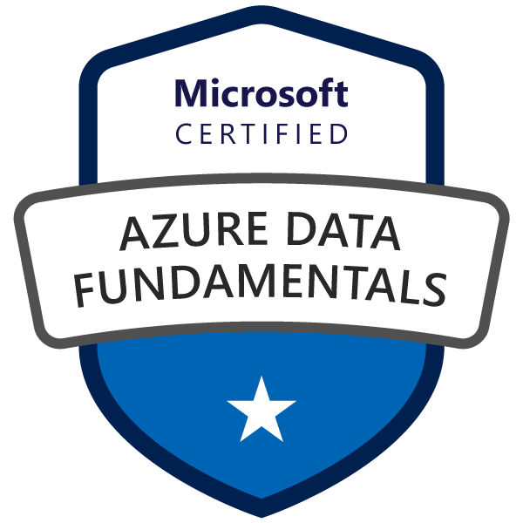


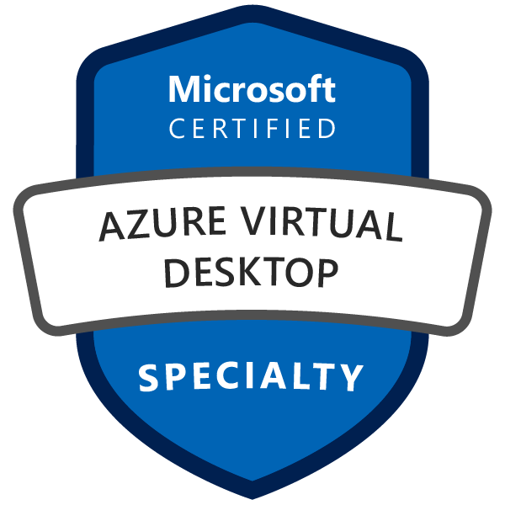




Speaker – Morten Knudsen

Slide 3


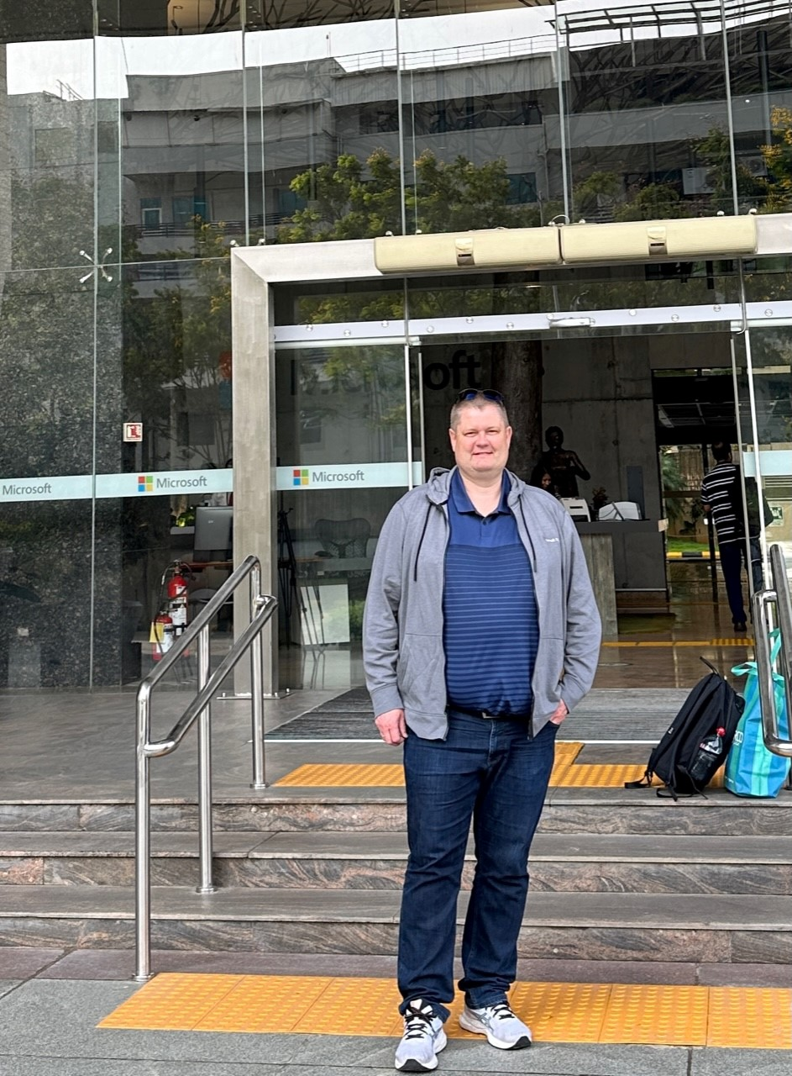
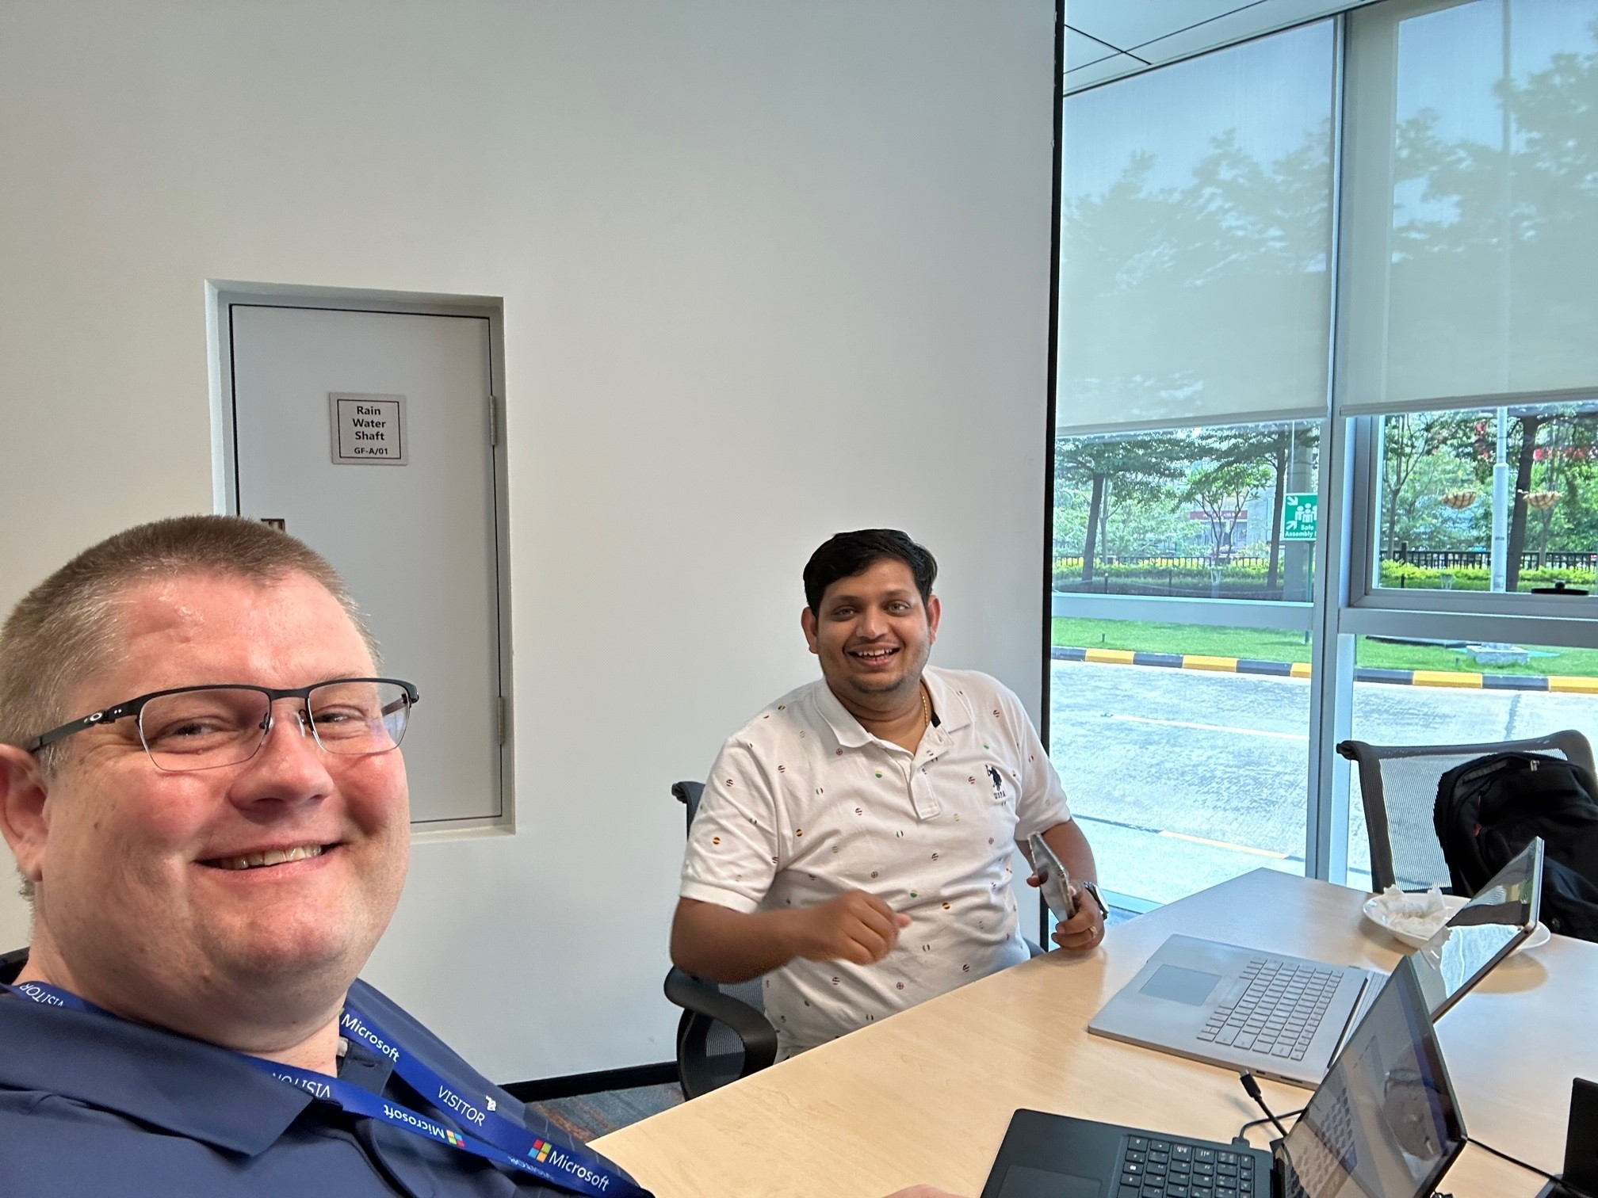

Slide 4


Session Objective – hopefully something for all ☺ Audience - we come from different background? Competency?
Introduction & Inspiration
How you can use the Microsoft technologies to build your own cool log integrations to work with facts – for a little cost, compared to value
Get inspired about Azure Logging capabilities - use-cases
try out showcase, ClientInspector – ready-to-use – free - community ☺
How-to migrate from Azure Logging V1 --> V2 - End of support (Aug 24)?
MMA → AMA
HTTP Data Collector REST API → Azure Log Ingestion Pipeline, Log Ingestion API, Transformation and Azure Data Collection Rules (End of support announcement soon)
Azure LogAnalytics custom tables v1 → v2
Data manipulation – Schema/Table Management - Data Transformation – Data Upload
“AnyConnector” → Introduction to your new helper → AzLogDcrIngestPS PS module
Where can I get more information ?

Slide 5
Showcase: Good Security demands to be and stay in control with the fundamentals !
Data Source/In
WMI
CIM
REST APIs
CSV
JSON
XML
Powershell cmdlets – get-mppreference
Registry
Files
Integration HR system
Security-portal (Advanced Hunting)- REST API
Logfiles
SQL performance counters
Databaser
Defender for Endpoint (MDE)
..
..
Data Collection
Pending Windows Updates
Members Local Admins
Bitlocker config
Window firewall settings
Hardware Serial Number
OS Last Restart
..
Desired State Dashboards (KPIs)
Computers with wrong/missing Bitlocker config
Computers with pending updates released more than 40 days ago
Unexpected shutdowns during last 24 hours
Incomplete Office update channel
Incompliant Real Protection antivirus
Computer not refreshing Group Policies during last 7 days
Advanced
Integrations
Alerts

Slide 6
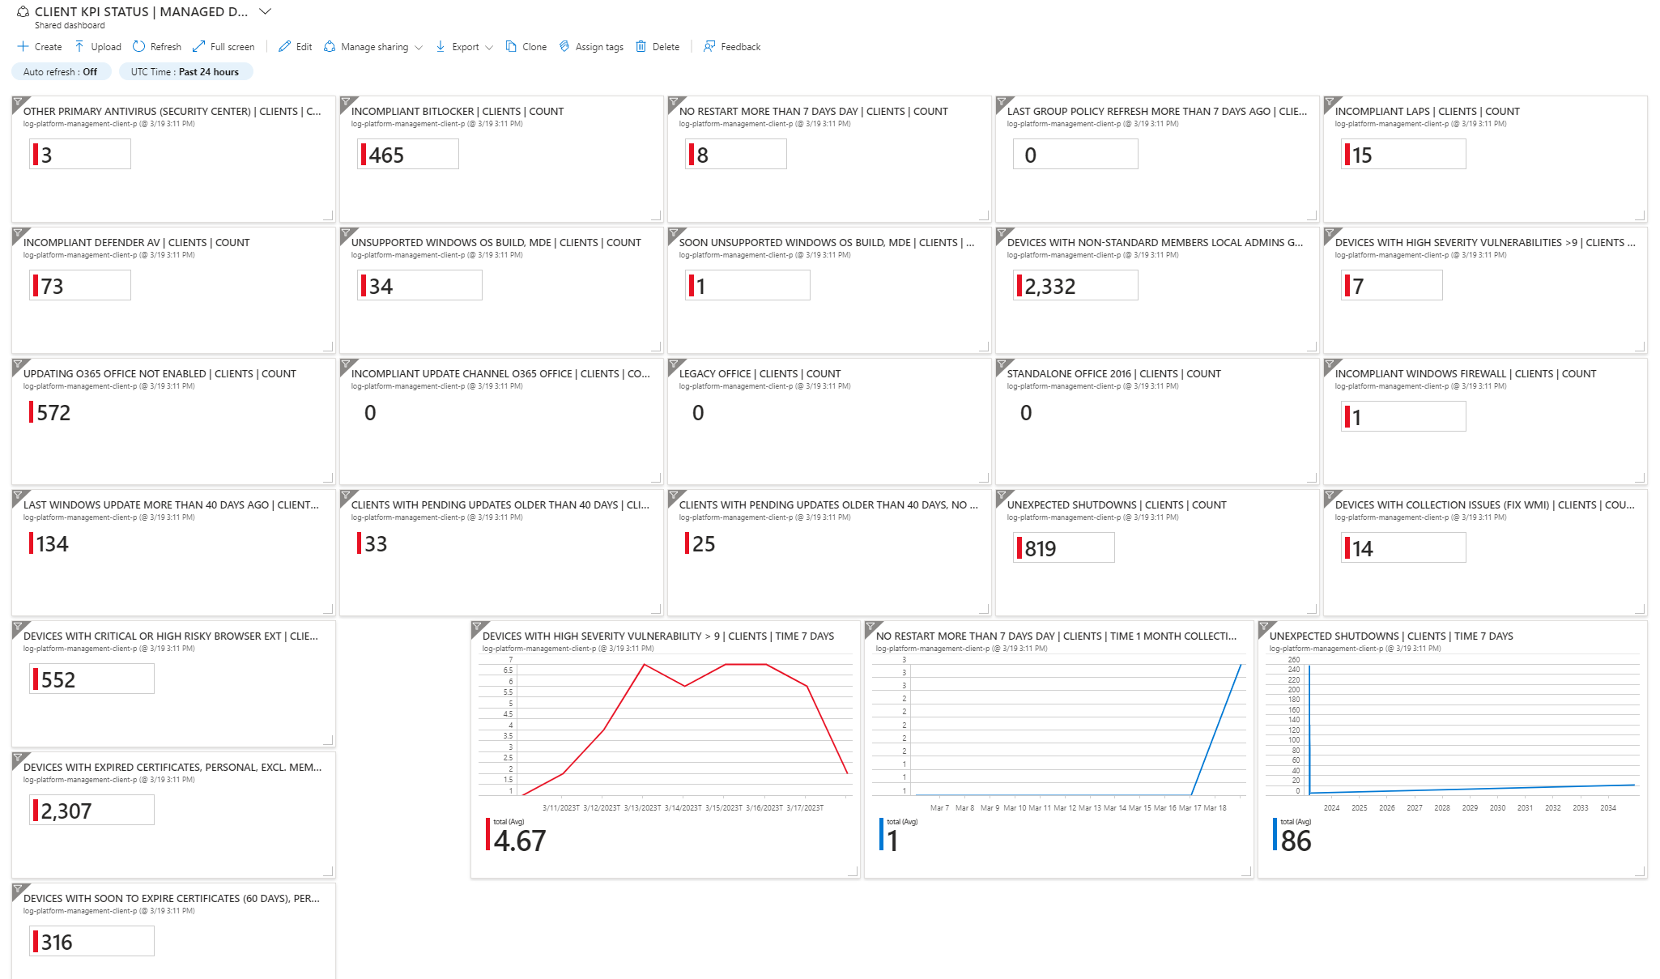

Slide 7
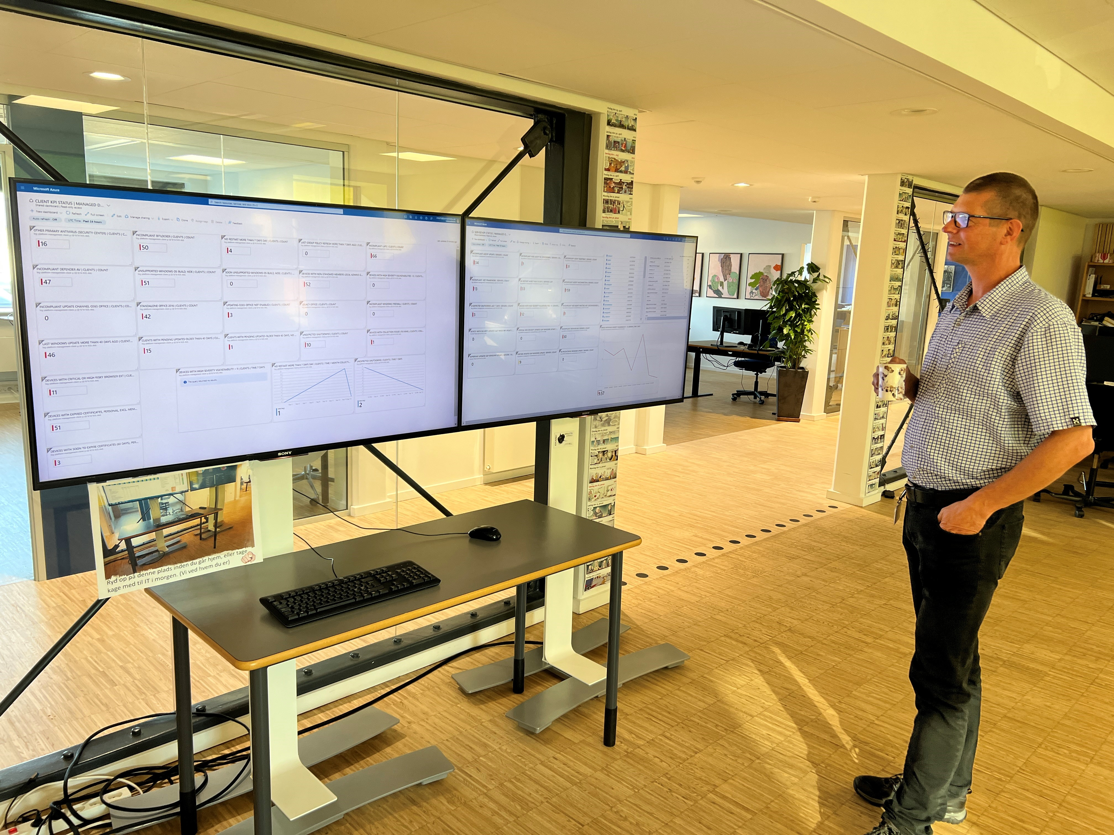


Showcase (how/what):
ClientInspector PS-script
Azure LogAnalytics tables
14x Azure Workbooks
15x Azure Dashboards
AzLogDcrIngestPS
Price per month:
Daily collection from 500 clients = USD 27 (DKK 200) / month

Slide 8
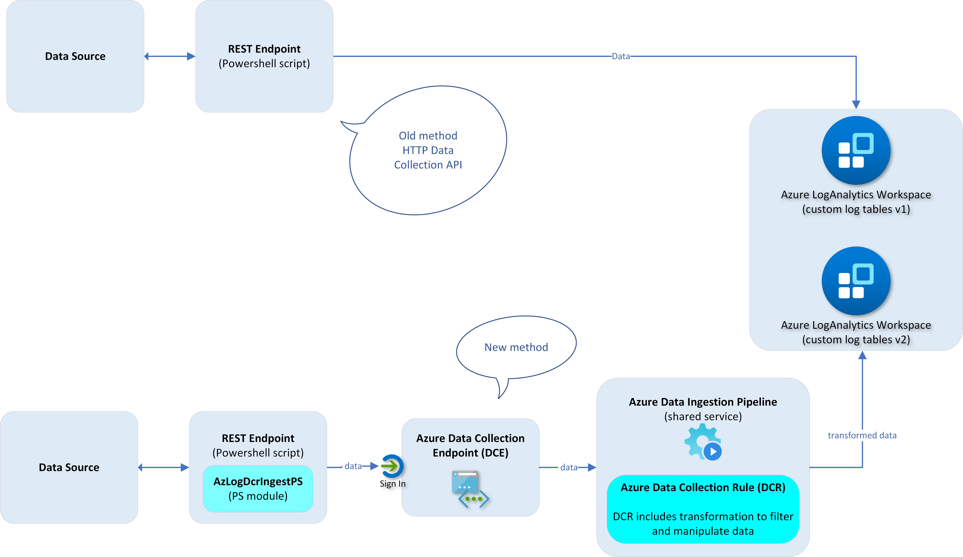

Slide 9
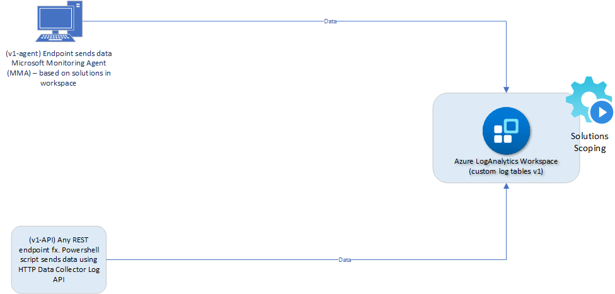

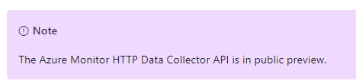
“V1” (legacy)
Custom tables (v1)
LA Solutions
MMA
Azure Monitor HTTP Data Collector API
Legacy but in “Public preview”?
what did I miss??
Response from product team
”Data Collector API was never officially released or considered “complete”
We are going to update Data Collector API documentation as part of its deprecation cycle”

Slide 10

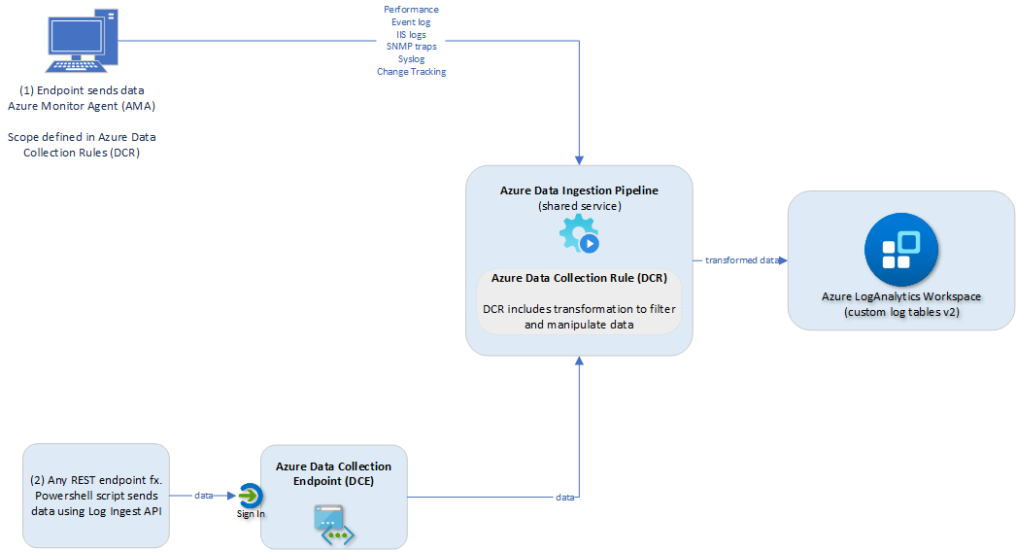

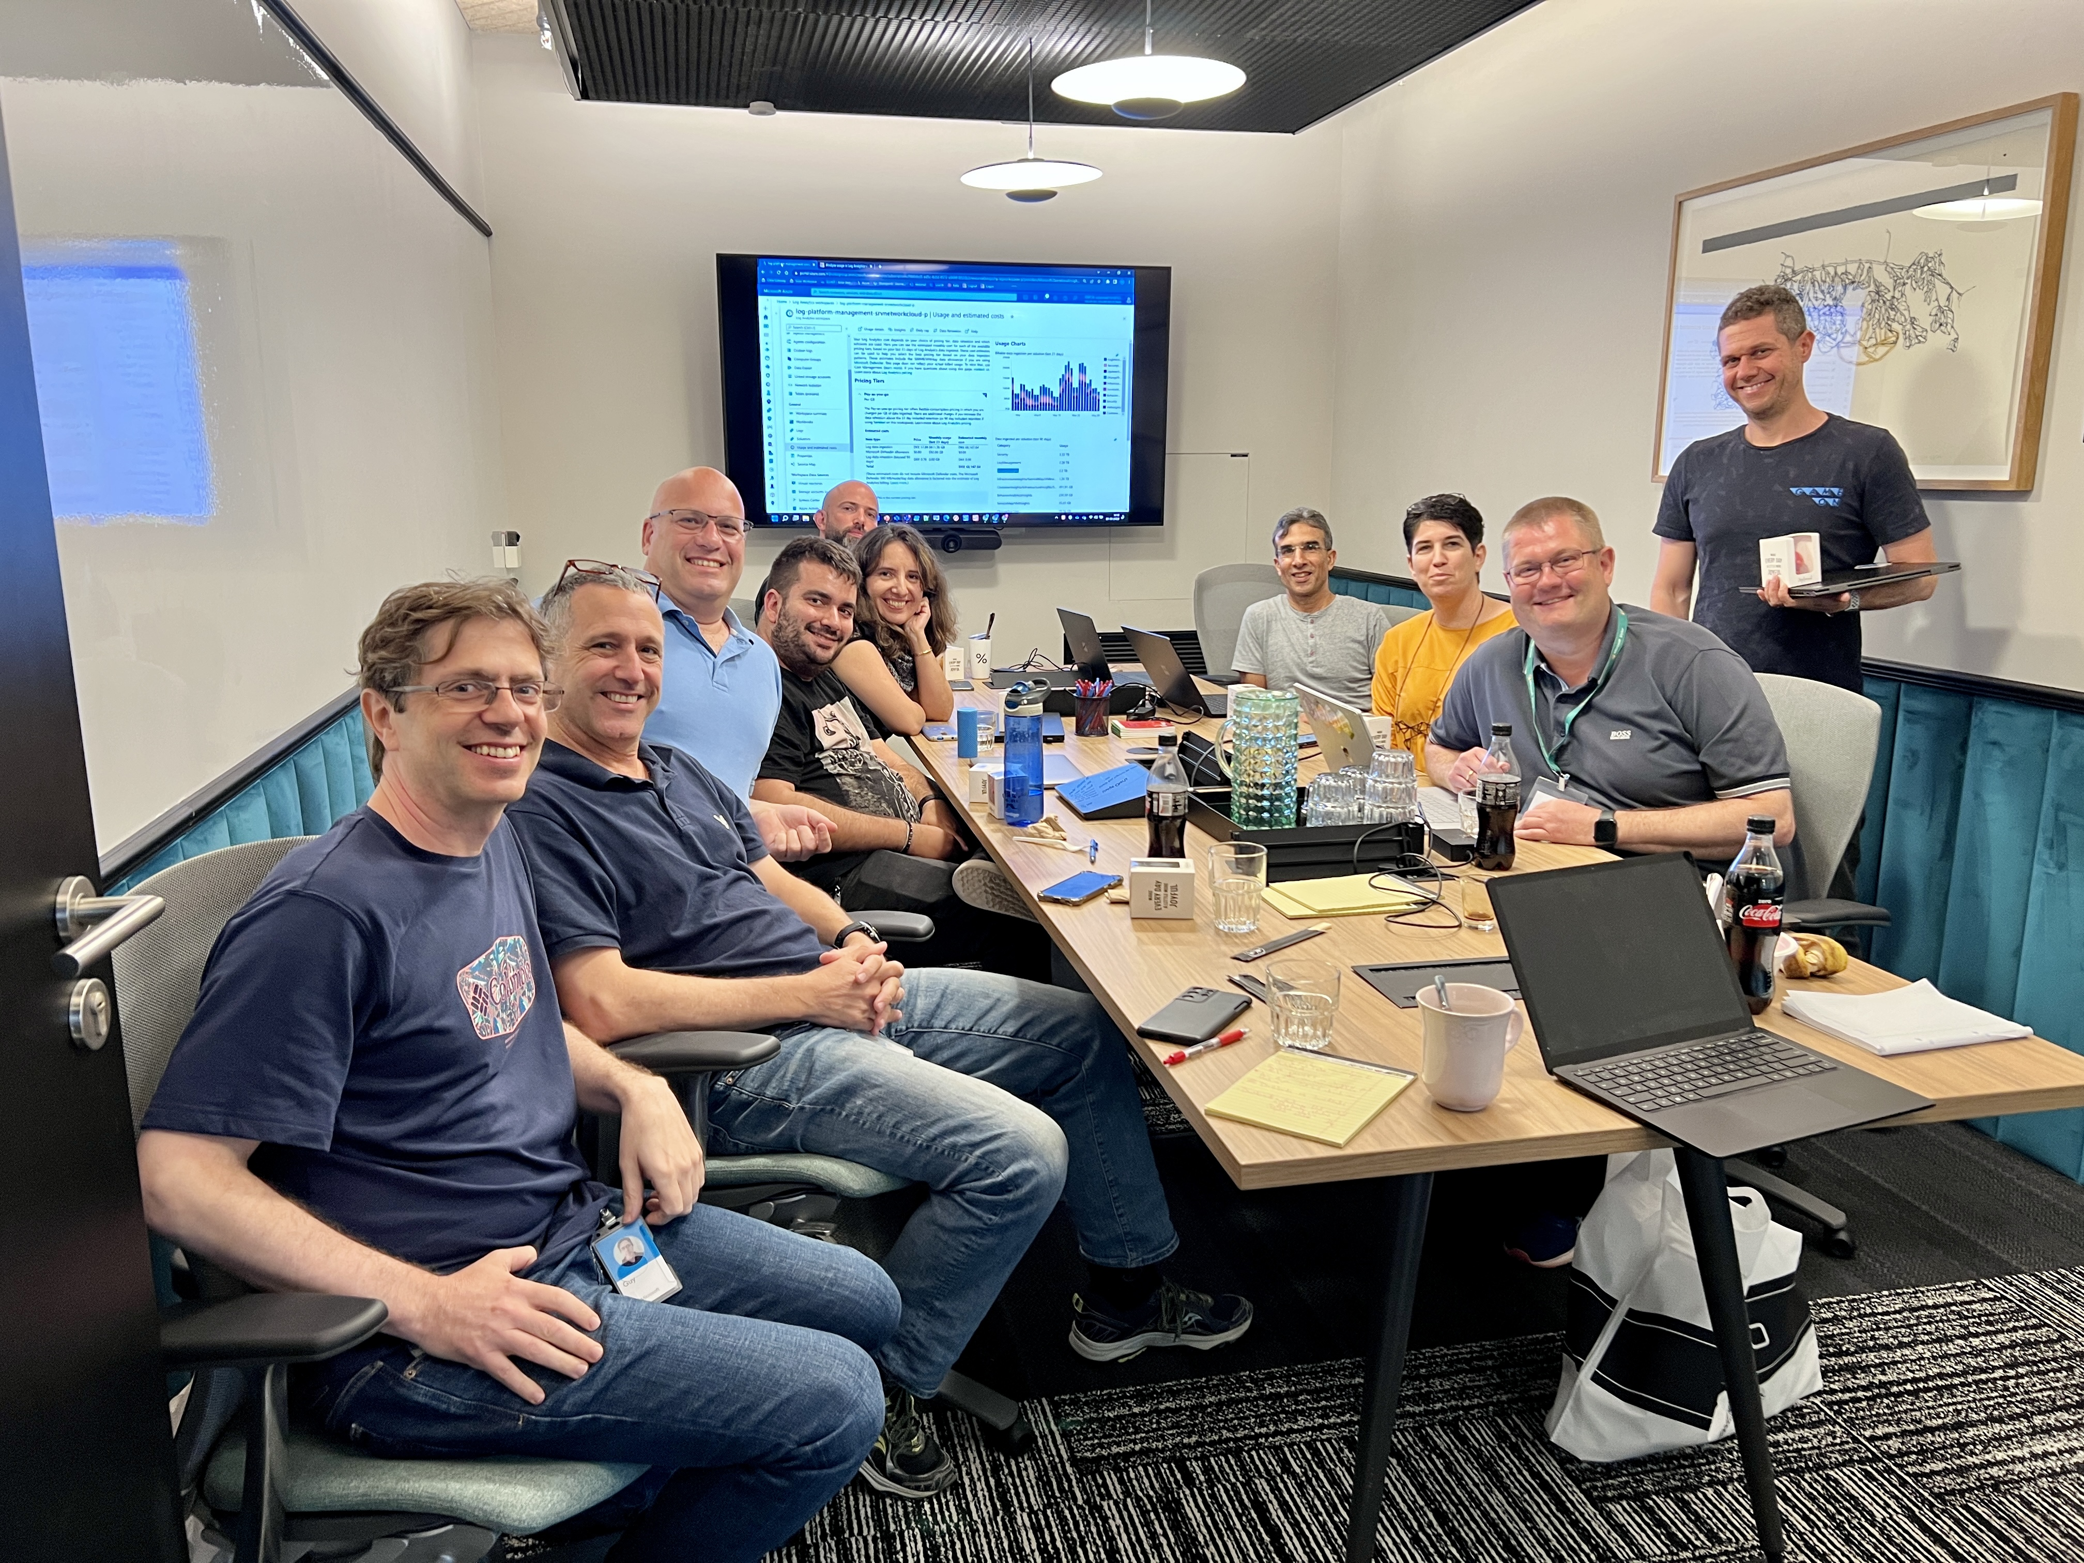
Azure DCR PMs & Dev Lead, Seattle, USA
“V2”
Azure Pipeline
DCRs
Transformation
DCEs
Custom tables (v2)
Azure Pipeline PMs, Seattle, USA
Azure LogAnalytics PMs, Israel

Slide 11
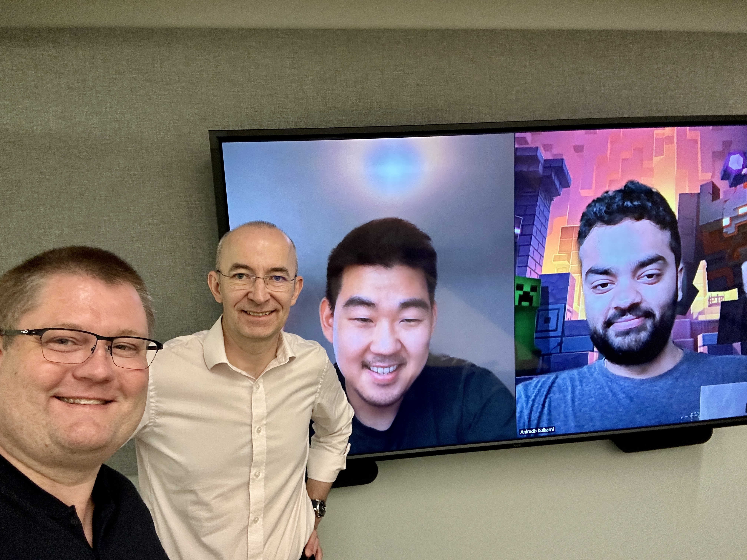

Azure Logging V2 – current data sources More capabilities are coming – I’m so excited ☺
Eventlogs
Performance Counters (SQL)
Performance metrics & telemetry
Standard/Platform metrics/Telemetry (AzPaaS)
IIS logs
Windows Fw Logs
Text logs
Meet the Azure Monitor PMs (Seattle, USA)
Change Tracking
Custom Logs (Ingestion API)
Custom metrics/telemetry (custom AzApp)
SNMP Traps
Platform logs (diagnostics)
Activity logs
Standard Logs (Ingestion API)

Slide 12
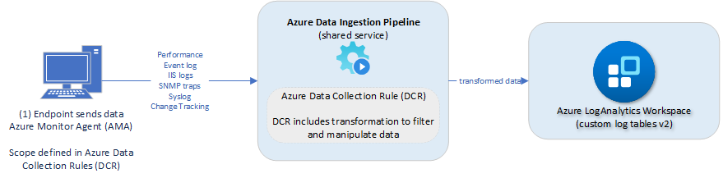


I’m fan ☺
remove data before being sent into LogAnalytics (remove "noice" data/cost optimization, GDPR/compliance)
add data before being sent into LogAnalytics
merge data before being sent into LogAnalytics
better data quality (array data), as array data is converted into dynamic - whereas the old MMA-method would convert array data into strings
support to send to other destinations
support for file-based logs collection (txt-logs, Windows Firewall logs)
advanced support for advanced collection of performance data (including new collection type like SQL performance counters)
support for SNMP traps logs collection
security is based on Azure AD RBAC
naming of data columns are prettier, as they contain the actual name - and not for example ComputerName_s indicating it is a string value
MS HQ - more really cool stuff is ‘in the oven being backed’ –
coming soon ☺

Slide 13

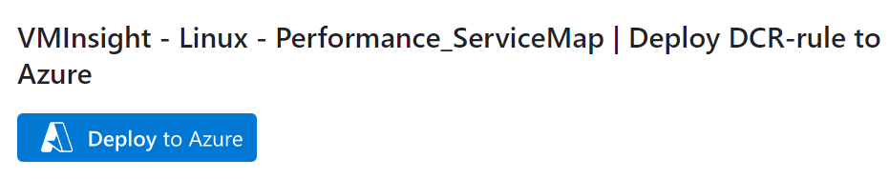
My contribution to get you started with Azure Logging v2 ??
12 new blogs + AzureLogLibrary.net (templates)
Topic | Link
Understanding Azure logging capabilities in depth | https://mortenknudsen.net/?p=1433
How to do data transformation using Workspace transformation for legacy upload methods | https://mortenknudsen.net/?p=1436
Understanding the fundamentals of log-collection with Azure Monitor Agent & Azure Data Collection Rules | https://mortenknudsen.net/?p=1438
Understanding Azure Data Collection Endpoint | https://mortenknudsen.net/?p=1442
Collecting Security events using Azure Monitor Agent | https://mortenknudsen.net/?p=1444
Collecting System & Application events using Azure Monitor Agent | https://mortenknudsen.net/?p=1446
Collecting Performance data using Azure Monitor Agent, VMInsights and ServiceMap | https://mortenknudsen.net/?p=1449
Collecting IIS logs using Azure Monitor Agent | https://mortenknudsen.net/?p=1451
Collecting text logs using Azure Monitor Agent | https://mortenknudsen.net/?p=1453
Collecting Syslogs using Azure Monitor Agent | https://mortenknudsen.net/?p=1455
Collecting CEF Syslogs using Azure Monitor Agent | https://mortenknudsen.net/?p=1457
Tutorial – How to make data transformations using Data Collection Rules? | https://mortenknudsen.net/?p=1440

Slide 14
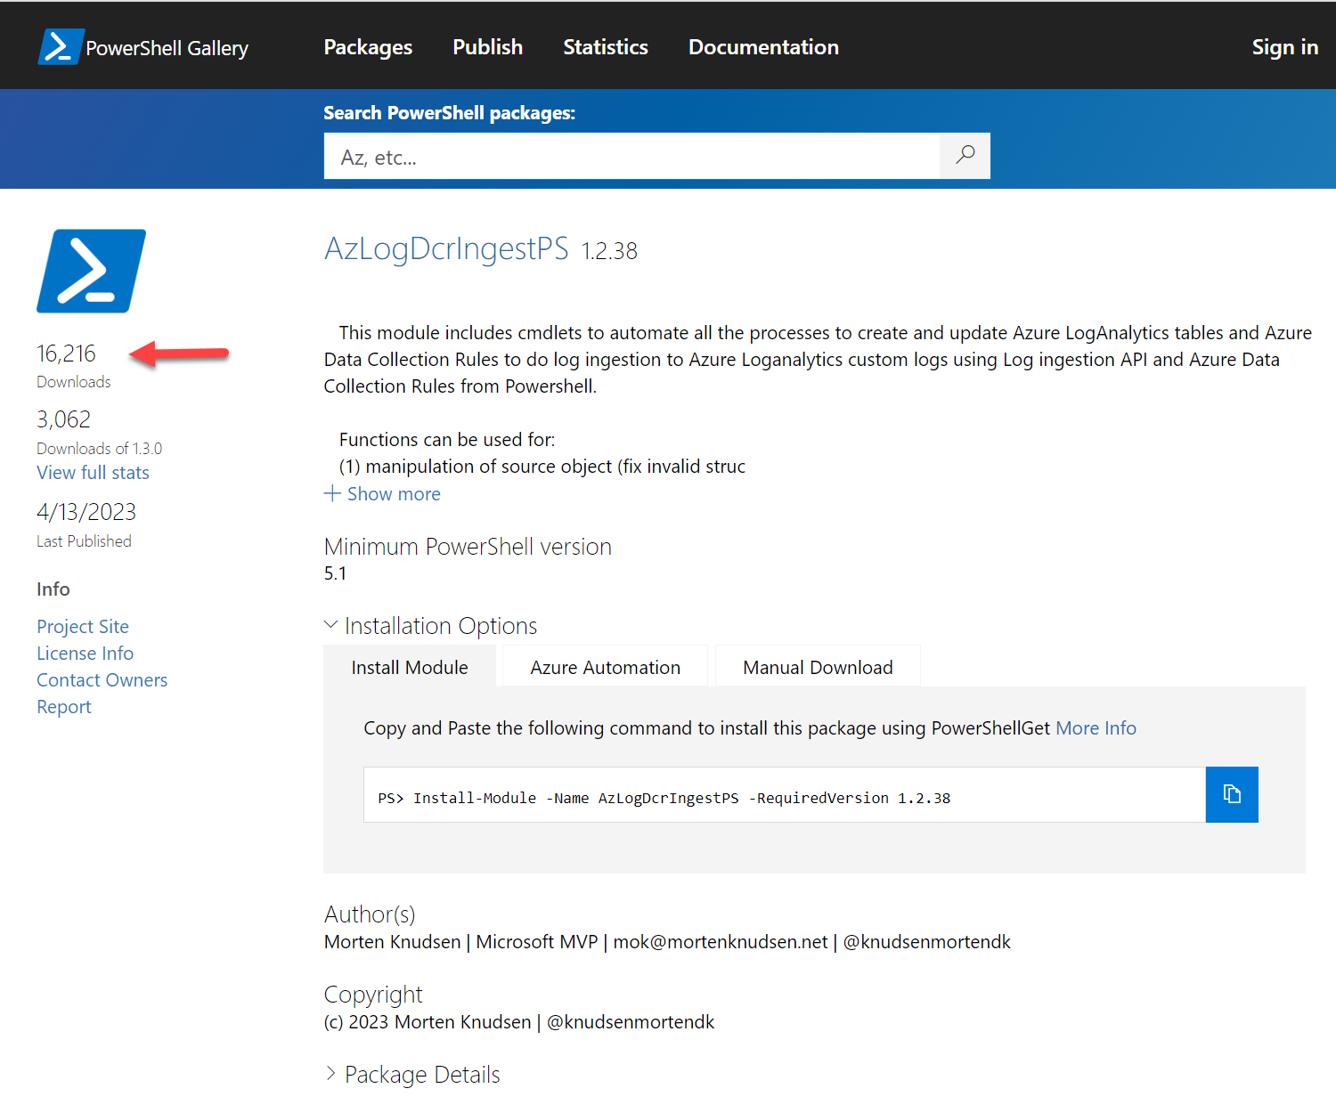


Challenges with v2 technologies compared to V1
25 functions
+6000 lines of code
Schema
Req: Creation of DCR + tables before sending data
Req: Data Collection EndPoint must exist
Req: Schema for data must be defined in both DCR and custom table (v2)
Naming conventions & limitations / Prohibited names
Handle new properties in source object (merge, overwrite)
Property changes -True (string) → True (Boolean) – “internal server 500”
Upload changes (32 mb -> 1 mb) per JSON (batches, calculations)
Data manipulations of source data (filtering, remove)
DCR limitations with large schema
create with limited schema first, then full schema
Azure seconds - timing / delays – dependencies
Platform – no-internet access, TLS incompatibility

Slide 15
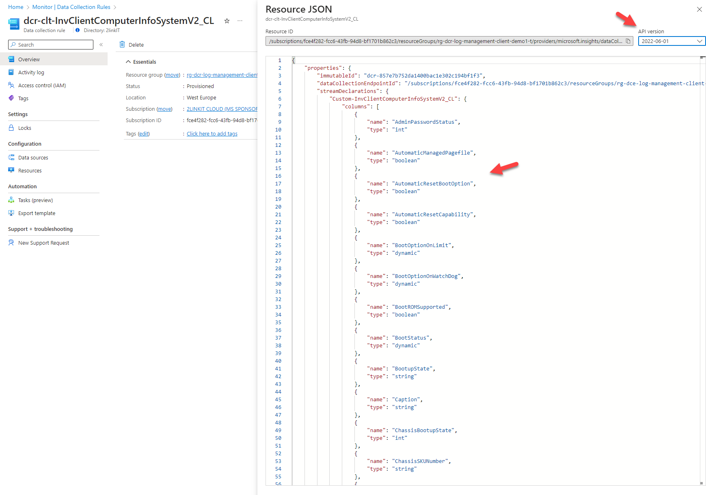
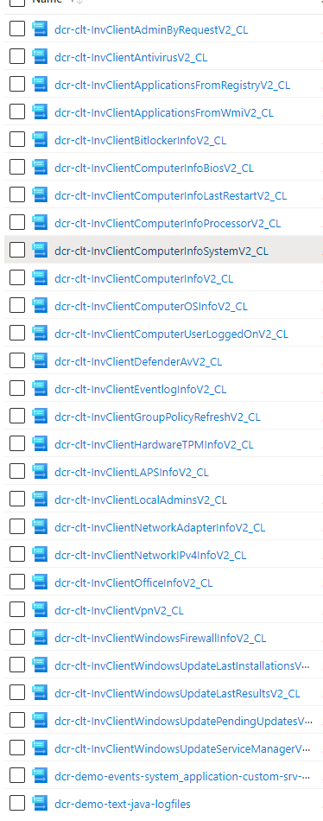

Slide 16
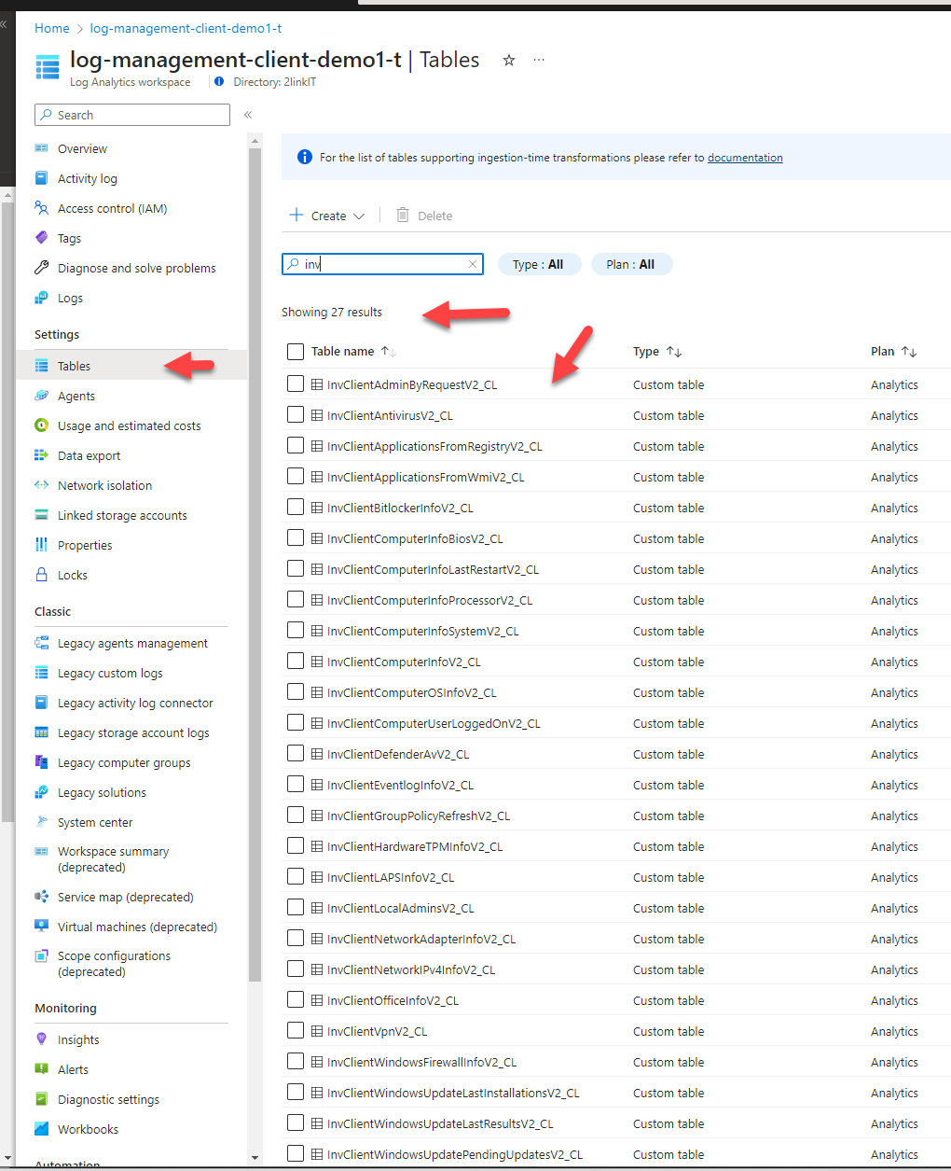
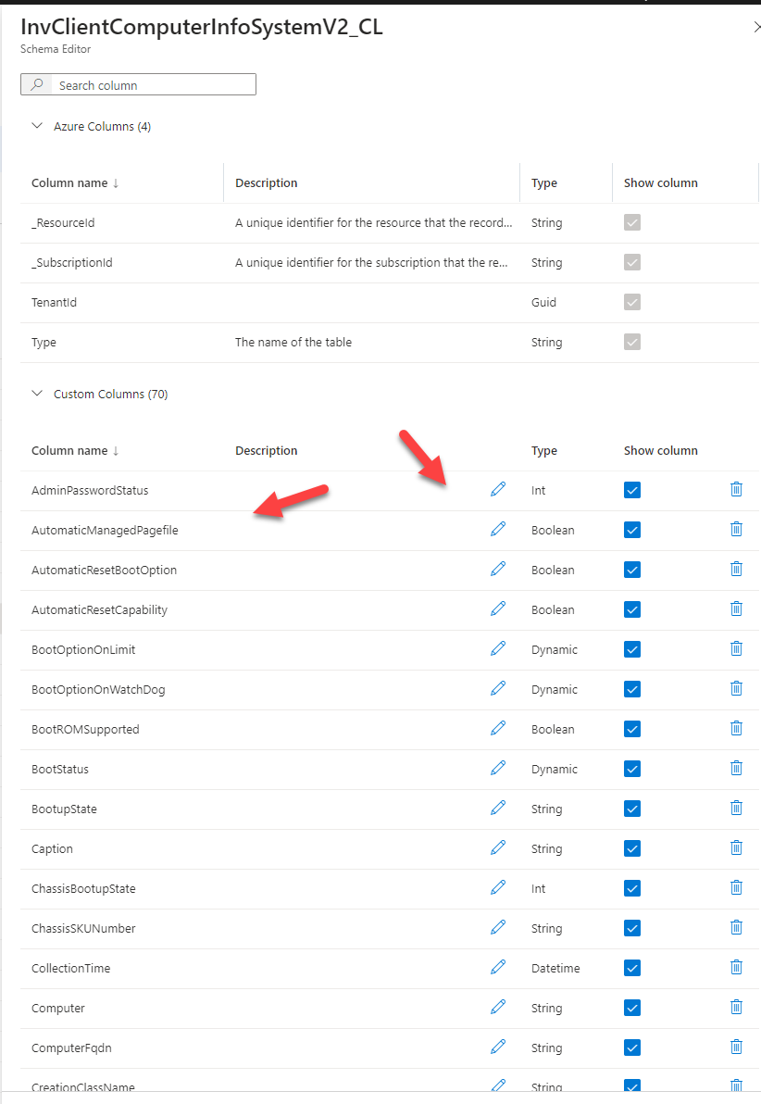

Slide 17
Use-Case | “AnyConnector” | AzLogDcrIngestPS
Detect local printers – replace with large multi-function printers (prepare business case)
PC replacement – yearly budget – Lenovo / Dell warranty
Cisco SecureX integration (REST API) – get alerts over
Cisco Prime (REST API) – wifi connectivity – which APs + SSID are users connecting to
SQL monitoring (WhoAmI)
Pull - Retrieve data from any 3rd party source using PS script (intermediate)
Push - Collect data from endpoint - send data from endpoint (ClientInspector)

Slide 18


Slide 19


Slide 20
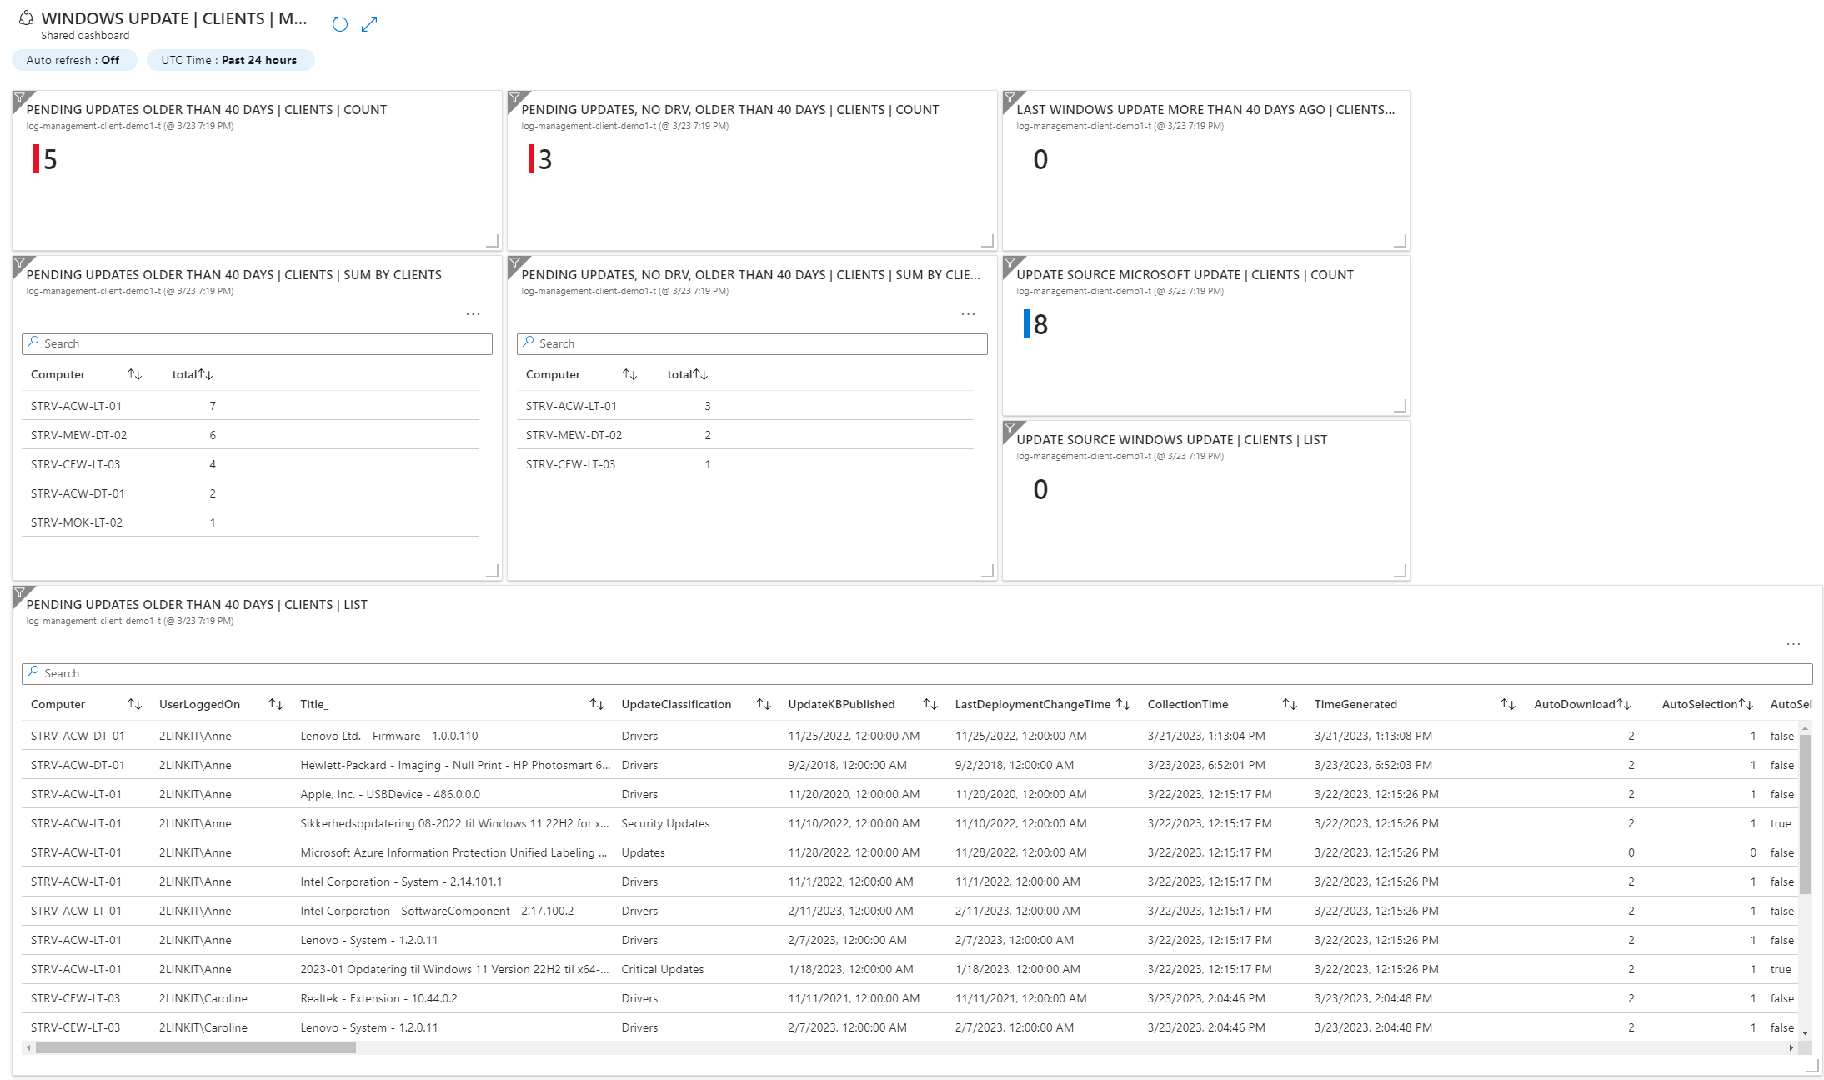

Slide 21
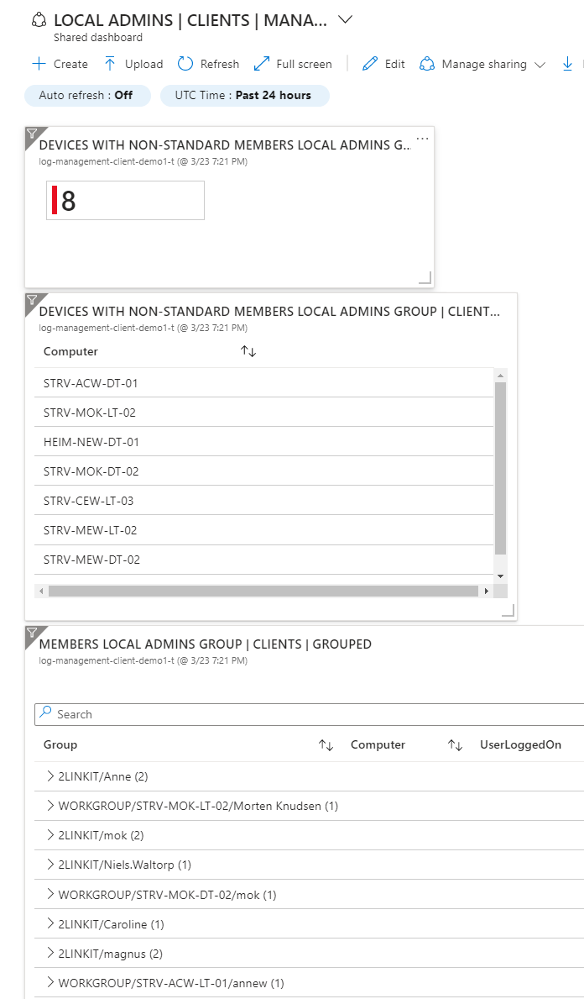


Slide 22
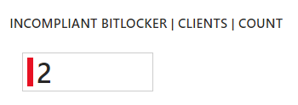
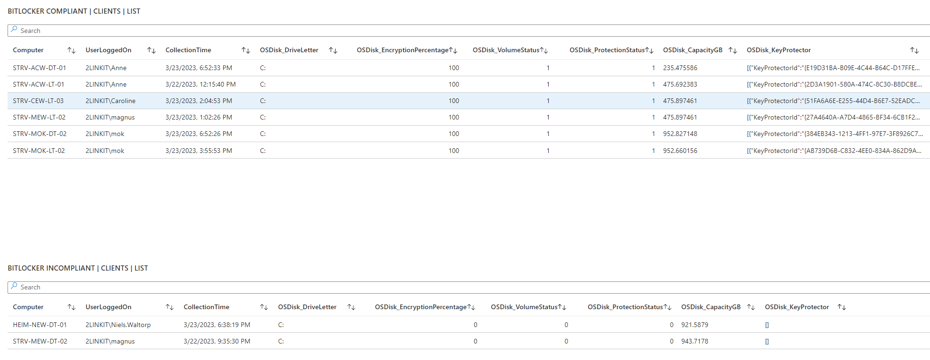

Slide 23
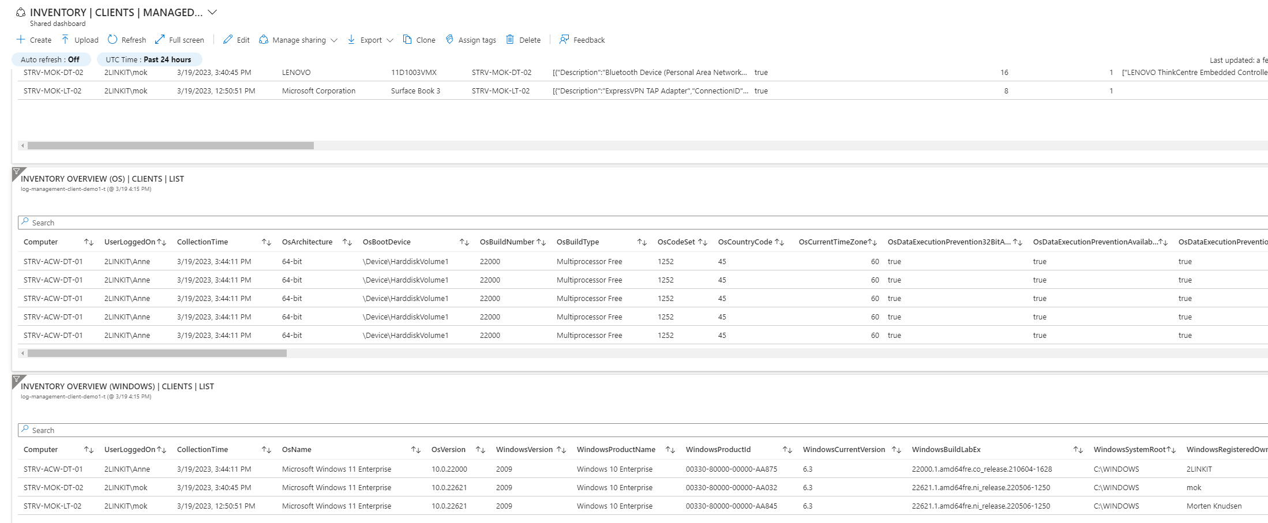

Slide 24
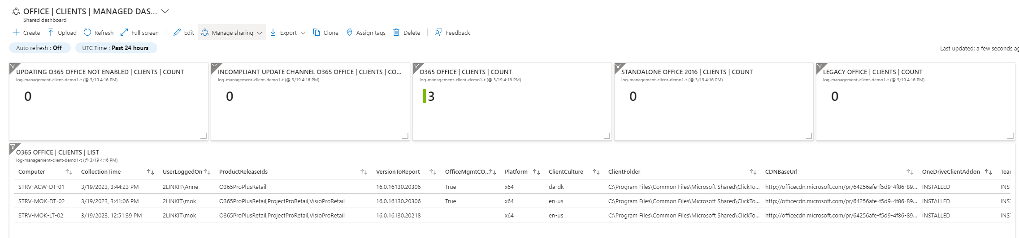

Meet the PMs in charge of Azure Workbooks & Azure Dashboards
– John & Shikha
(Seattle, USA)

Slide 25
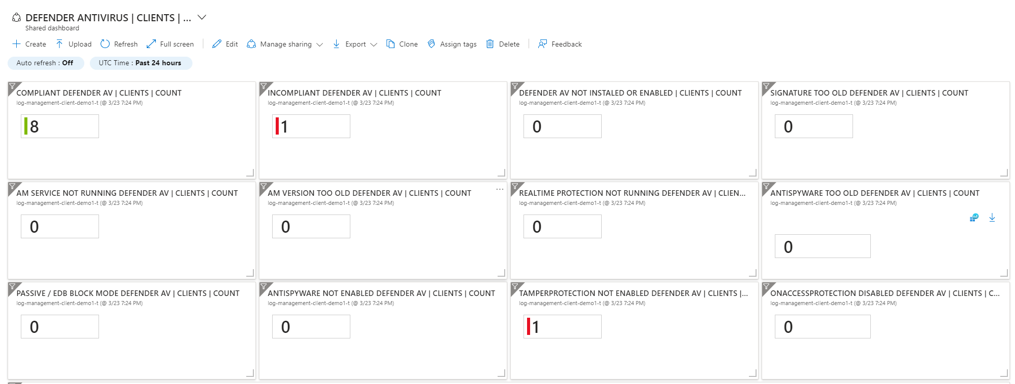

Slide 26
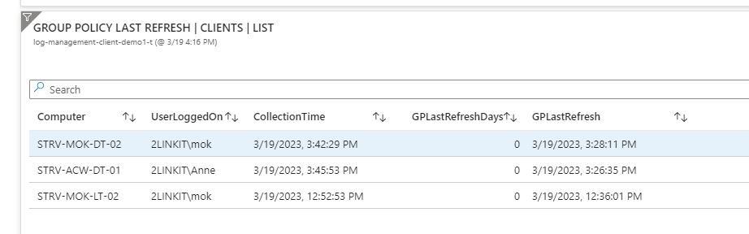
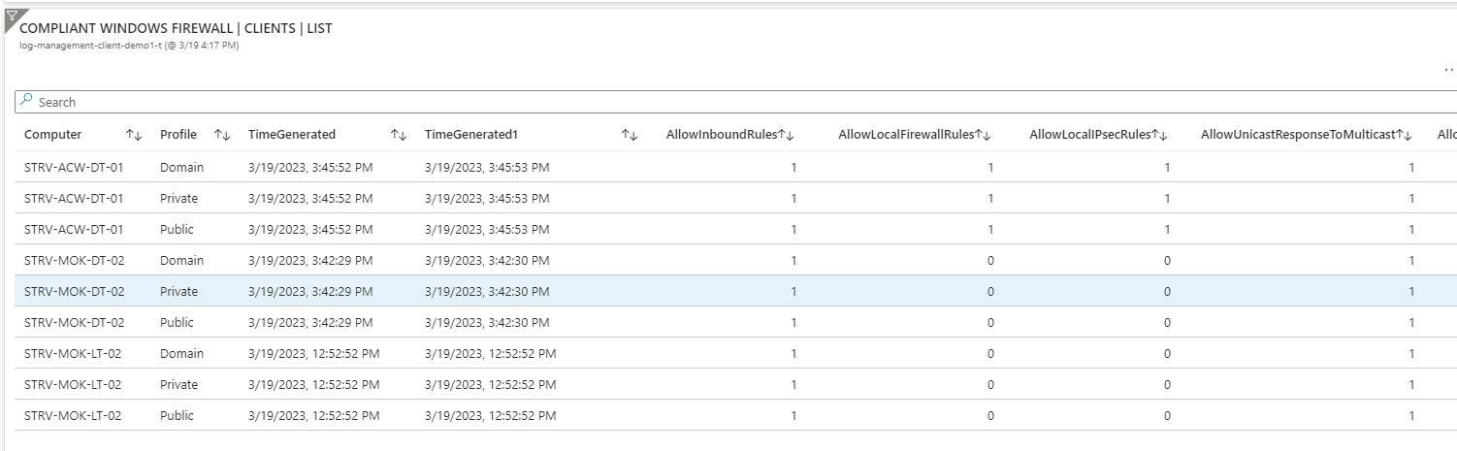

Slide 27
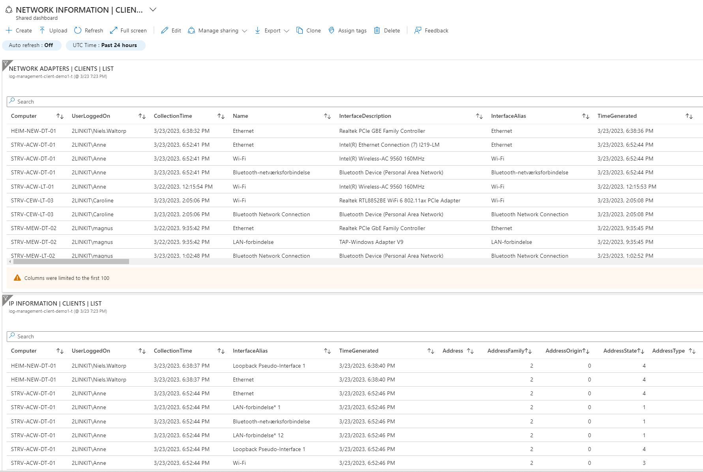

Slide 28
Warranty lookup Lenovo – via collected data (online)

Slide 29
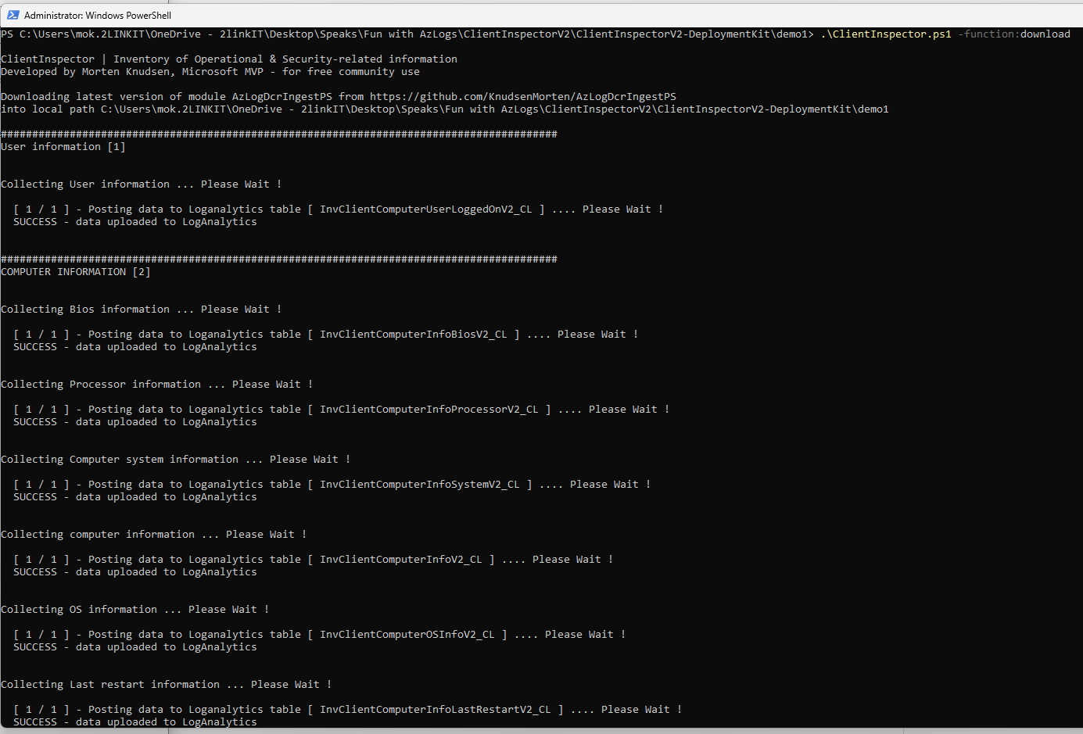
Run with
ConfigMgr
Intune
any deployment-tool
Servers:
RemotePS
CustomScript Extension

Slide 30
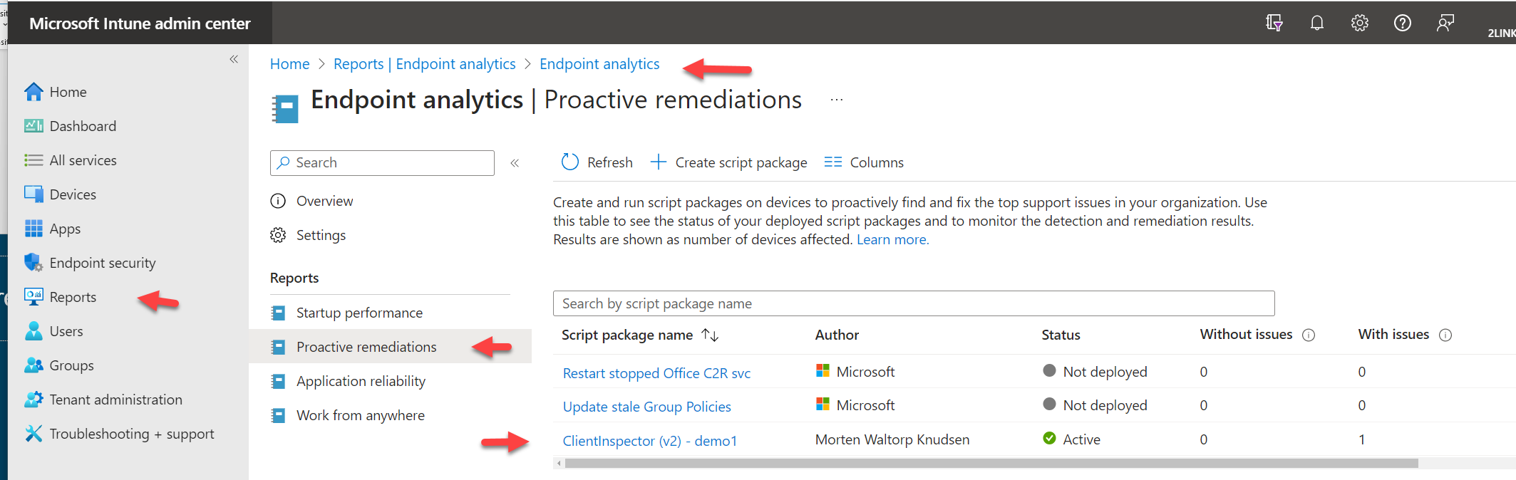
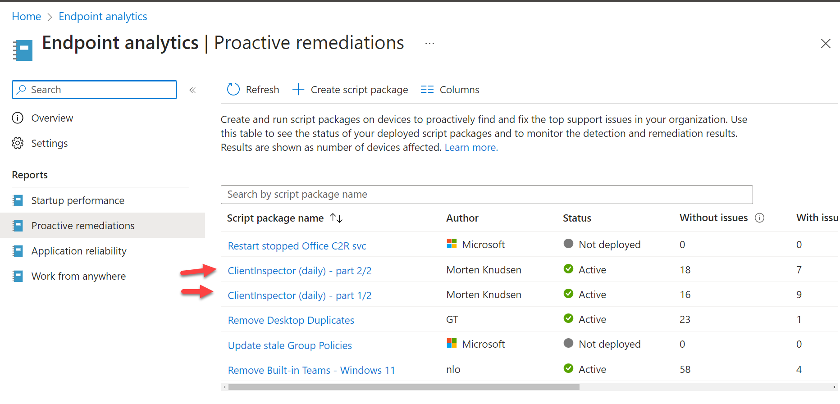
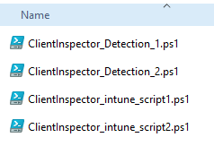
Intune deployment (<200 Kb in size)
Intune deployment >200 Kb size, split

Slide 32
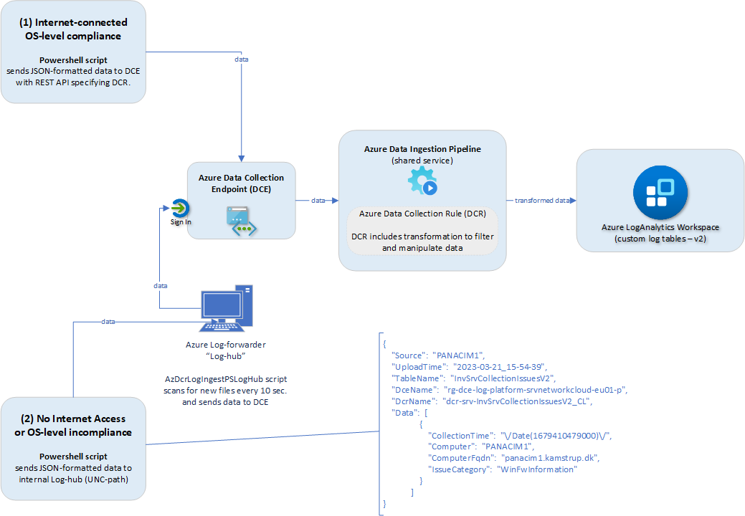
LogHub
Available on Github
Free

Slide 33
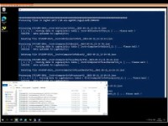

Slide 35
Query

Slide 36
Workbooks & Dashboards

Slide 37

“AnyConnector” | AzLogDcrIngestPS
Data In (“AnyConnector”)
Data Manipulate
Table/DCR/Schema/ Transformation management
Upload data to LA
Support
Security (token REST)
remove data from the source object, if there are colums of data you don't want to send
convert source objects based on CIM or PS objects into PSCustomObjects/array
add relevant information to each record like UserLoggedOn, Computer, CollectionTime
Data Upload
SchemaMode = Overwrite
validate the schema for naming convention issues. If exist found, it will mitigate the issues
auto-fix if something goes wrong with a DCR or table (DELETE/PUT)
SchemaMode = Merge & Overwrite
SchemaMode = Merge
create/update the tables automatically - based on the source object schema (add new properties to existing).
create/update DCR based on table schema
create/update the DCRs and tables automatically - based on the source object schema
Automatic calculation of batches (json size)
Can be overwritten by batchAmount <number>
Maintenance (delete)
Transformations (GET, UPDATE, RESET)
List DCRs/DCEs
WMI, CIM, REST API, DBs, CSV, JSON, XML, etc.

Slide 38
“AnyConnector” | AzLogDcrIngestPS
Data Manipulate
Table/DCR/Schema/ Transformation management
Add-ColumnDataToAllEntriesInArray
Add-CollectionTimeToAllEntriesInArray
Data Upload functions
Step 1 (get status)
Build-DataArrayToAlignWithSchema
Step 2 (convert structure)
Step 6 (align data structure)
ValidateFix-AzLogAnalyticsTableSchemaColumnNames
Convert-CimArrayToObjectFixStructure
Convert-PSArrayToObjectFixStructure
Filter-ObjectExcludeProperty
Step 4 (add more data)
Step 3 (remove unessary data)
Step 5 (validate/fix naming)
Get-AzLogAnalyticsTableAzDataCollectionRuleStatus
Step 2a (create/update LA table)
Step 2 (create/update table + DCR – main function)
Get-ObjectSchemaAsHash
Step 1 (get schema of data)
Get-ObjectSchemaAsArray
CreateUpdate-AzDataCollectionRuleLogIngestCustomTables
CreateUpdate-AzLogAnalyticsCustomLogTableDcr
Step 2b (create/update DCR)
Step 1 (post data)
Step 1a (post data)
CheckCreateUpdate-TableDcr-Structure
Get-ObjectSchemaAsHash
Post-AzLogAnalyticsLogIngestCustomLogDcrDce-Output
Post-AzLogAnalyticsLogIngestCustomLogDcrDce
Get-AzDcrListAll
Get-AzDcrDceDetails

Slide 39
“AnyConnector” | AzLogDcrIngestPS
Get-AzDcrListAll
Update-AzDataCollectionRuleResetTransformKqlDefault
Update-AzDataCollectionRuleTransformKql
Get-AzAccessTokenManagement
Delete-AzLogAnalyticsCustomLogTables
Delete-AzDataCollectionRules
Get-AzDcrDceDetails
Find DCE/DCR using ARG
Transformation
Get-AzDataCollectionRuleTransformKql
Security (token REST)
Maintenance
Update-AzDataCollectionRuleDceEndpoint
Support functions

Slide 40
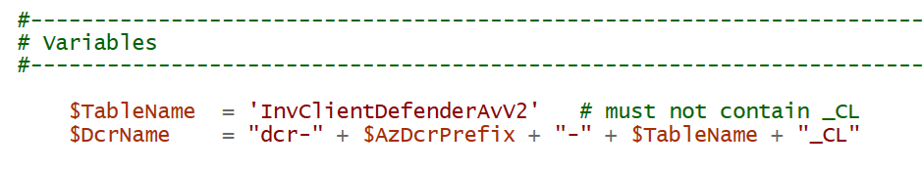
Variables (1/4) naming - where to send the data

Slide 41
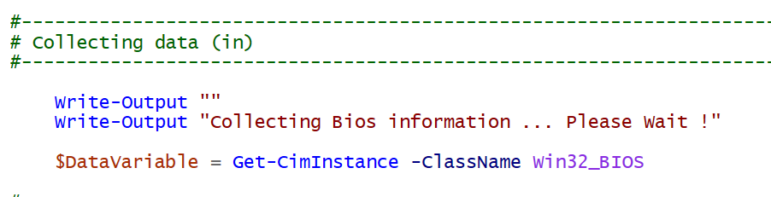
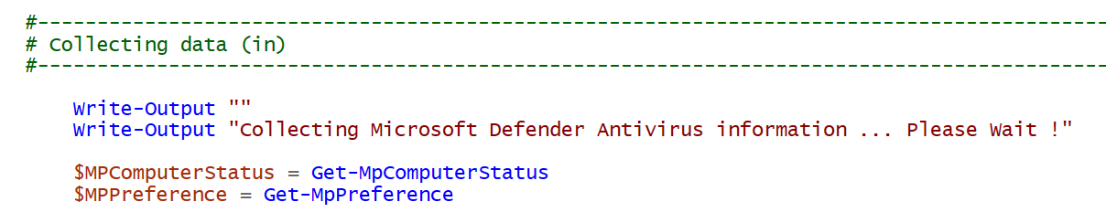
Data Collection (2/4)

Slide 42
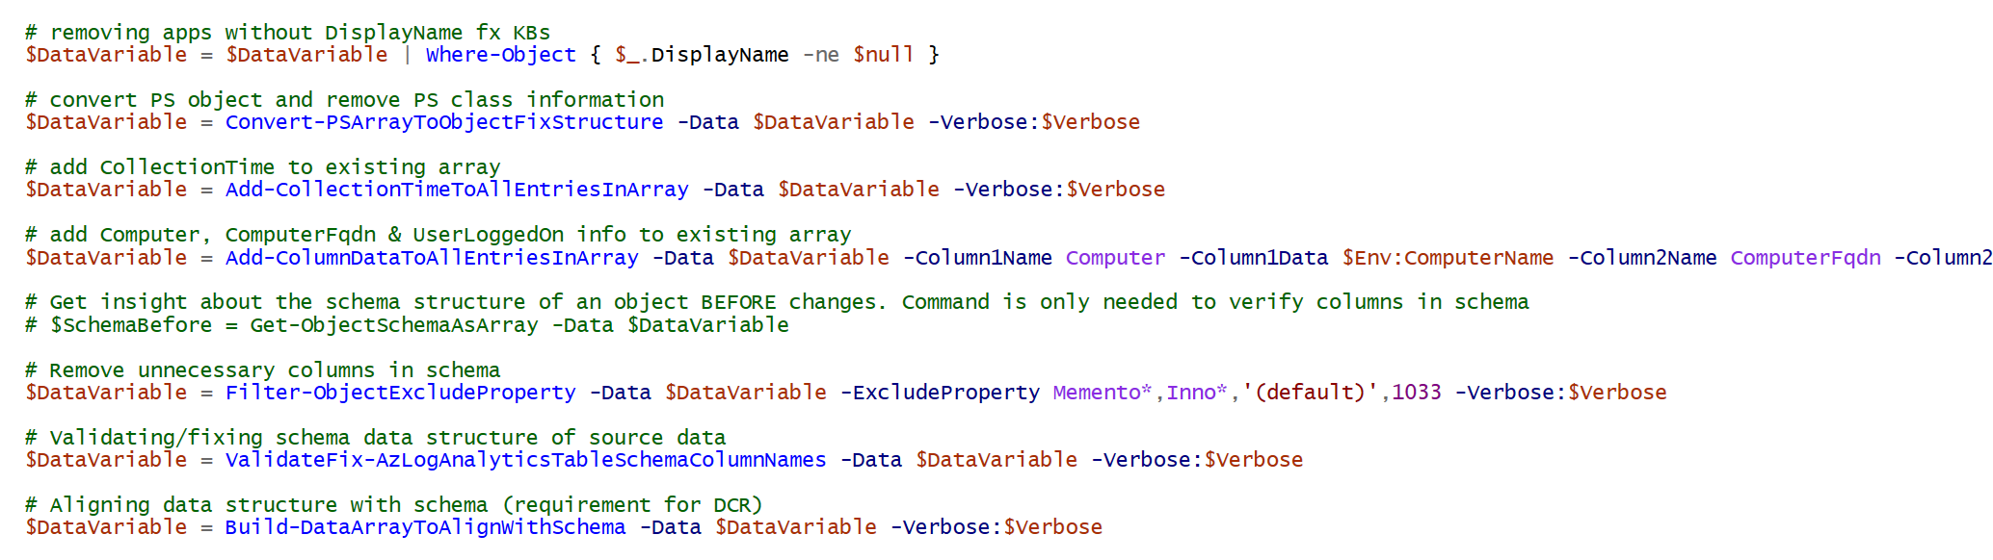
Data Manipulation (3/4) ensure data is in correct format and any "noice" was removed and relevant information has been added

Slide 44
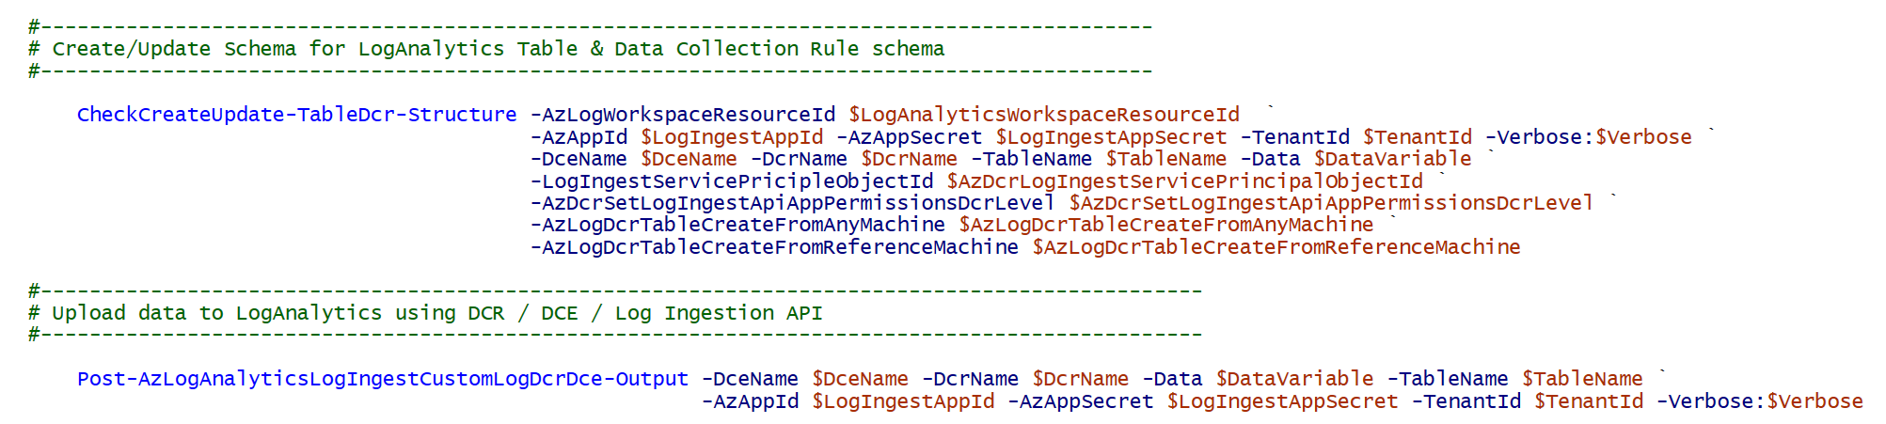
Data Out (4/4) send to LogAnalytics - combined functions

Slide 46

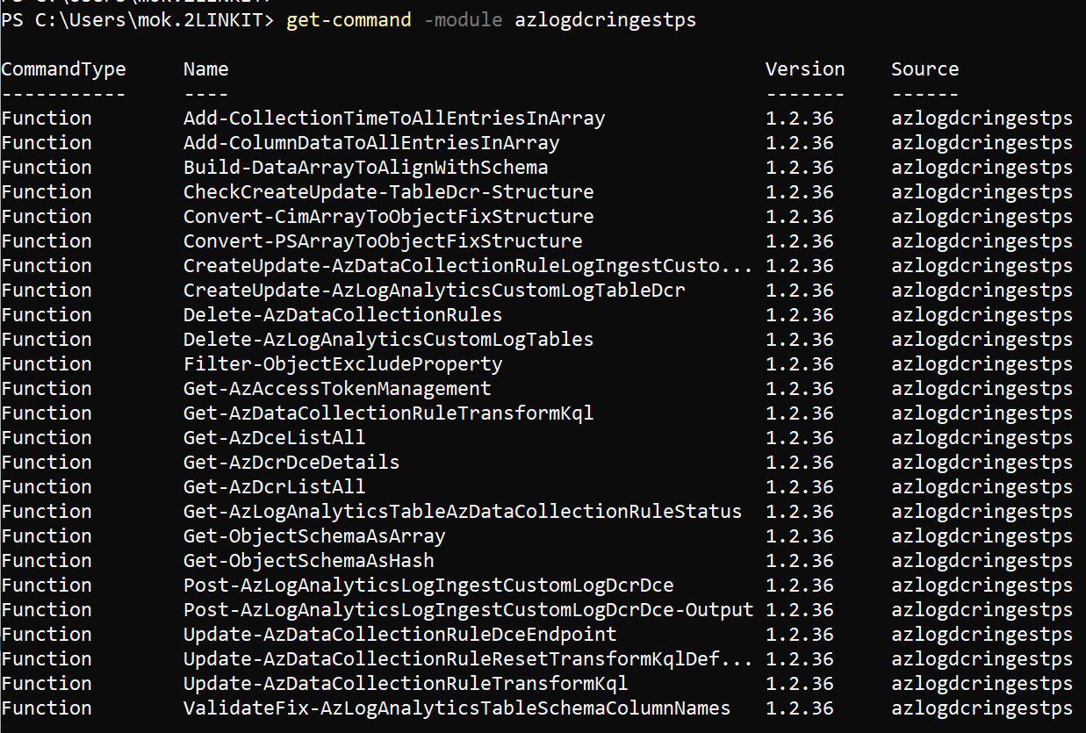
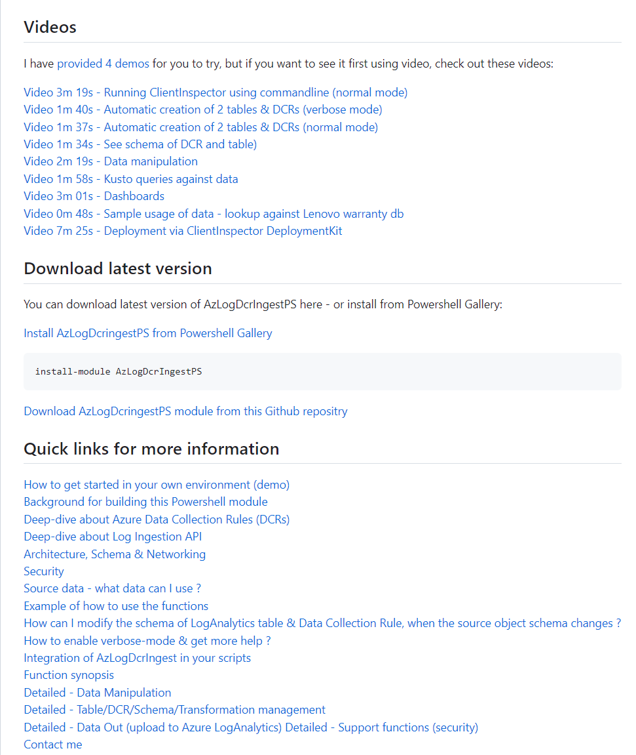
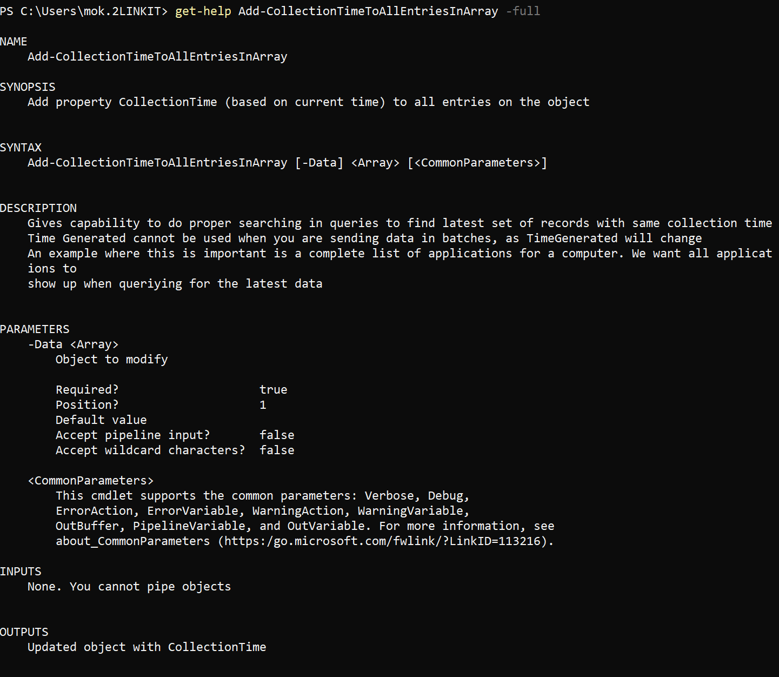
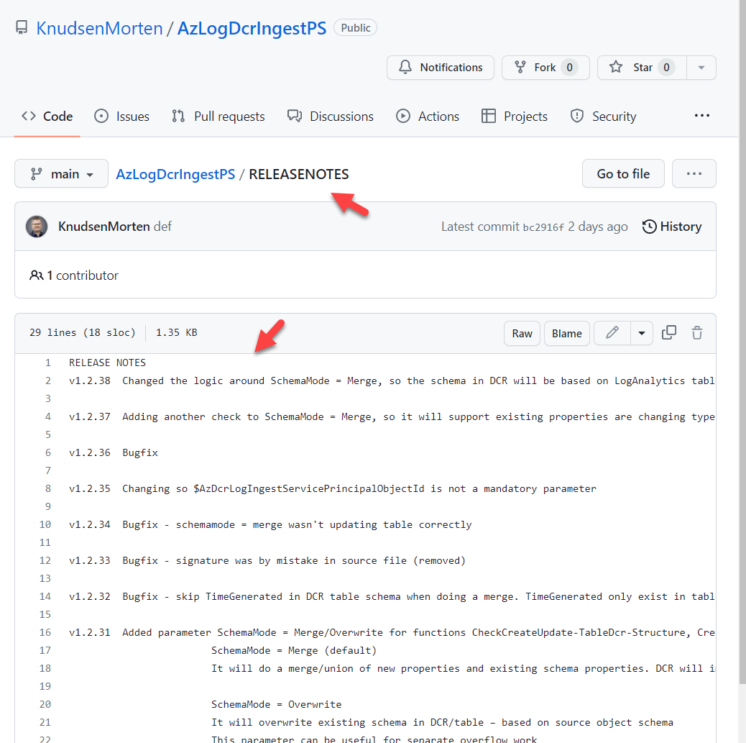
Detailed Documentation
https://github.com/KnudsenMorten/AzLogDcrIngestPS

Slide 47




How to get started ?
How to get started ? (demo)

Slide 48


https://github.com/KnudsenMorten/ClientInspectorV2-DeploymentKit
You can get started today
for free (only pay for Azure consumption)

Slide 50

Thank You for today ☺
Blog: https://mortenknudsen.net/
Mail: mok@mortenknudsen.net | mok@2linkit.net
Linkedin: https://www.linkedin.com/in/mortenwaltorpknudsen/
Github: https://github.com/KnudsenMorten
Twitter: https://twitter.com/knudsenmortendk
Topic | Link
ClientInspector | https://github.com/KnudsenMorten/ClientInspectorV2
ClientInspector DeploymentKit | https://github.com/KnudsenMorten/ClientInspectorV2-DeploymentKit
Powershell module AzLogDcrIngestPS | https://github.com/KnudsenMorten/AzLogDcrIngestPS
LogHub (AzLogDcrIngestPSLogHub) | https://github.com/KnudsenMorten/AzLogDcrIngestPSLogHub
Deep-dive about Azure Data Collection Rules (DCRs) | https://github.com/KnudsenMorten/AzLogDcrIngestPS#deep-dive-about-azure-data-collection-rules-dcrs
Deep-dive about Log Ingestion API | https://github.com/KnudsenMorten/AzLogDcrIngestPS#deep-dive-about-log-ingestion-api

Slide 51
More deep-dive information, if people are interested (not part of main presentation)

Slide 52
What is collected ?
User Logged On to Client
Computer information
bios, processor, hardware info, Windows OS info, OS information, last restart
Installed applications
both using WMI and registry
Antivirus Security Center from Windows
default antivirus, state, configuration
Microsoft Defender Antivirus
all settings including ASR, exclusions, realtime protection, etc
Office - version, update channel config, SKUs
VPN client - version, product
LAPS – version
Admin By Request (3rd party) – version
Bitlocker - configuration
Windows Update
last result (when), windows update source information (where), pending updates, last installations (what)
Eventlog
look for specific events including logon events, blue screens, etc.
Network adapters - configuration, installed adapters
IP information for all adapters
Local administrators group membership
Windows firewall
settings for all 3 modes
Group Policy - last refresh
TPM information
relevant to detect machines with/without TPM

Slide 53



Slide 54




Slide 57

Networking
Client endpoint (REST api)
sends data to DCE

Slide 58


Slide 59

Transformation using AMA & DCR

Slide 60

Transformation using Log ingestion API, DCR & DCE

Slide 61

Workspace Transformation DCR

Slide 62
Collection Source | Technologies needed | Resource Association | Target (today)
Performance Eventlog Syslog | AMA / DCR | Required (DCR) | Standard table (LogAnalytics)
Text logs IIS logs Windows Firewall logs (preview) | AMA / DCR / DCE | Required (DCR) | Custom Log table (LogAnalytics)
SNMP traps | Linux with SNMP trap receiver -and- AMA (syslog file) / DCR - or - AMA (syslog stream) / DCR | Required (DCR) | ???? (LogAnalytics)
Change Tracking (legacy | Change Tracking extension (FIM) / DCR | Required (DCR) | Standard table (LogAnalytics)
Custom logs (Log Ingest API) | DCR / DCE | N/A | Custom Log table (LogAnalytics)
Standard logs (Log Ingest API) (*) | DCR / DCE | N/A | Standard table (LogAnalytics)
Standard/Platform Metrics/Telemetry (Azure Paas) | DCR (built-in, non-manageable, hidden) | N/A | Azure Monitor Metrics
Custom Metrics/Telemetry (custom app) | AMA / DCR -or – Azure Diagnostics extension -or- Azure Monitor REST API -or- Linux: InfluxData Telegraf agent (Linux) + Azure Monitor output plugin | Required (DCR) | Azure Monitor Metrics
Platform Logs (diagnostics per resource) AllMetrics (don’t send to LA – you already have data via Azure Monitor Metrics) Resource logs (alllogs, audit) | Azure Policy (Diagnostics) DCR (built-in, non-manageable, hidden) | Required (Policy) | Standard table (LogAnalytics)
Activity logs (audit per subscription) | Azure Policy (Diagnostics) DCR (built-in, non-manageable, hidden) |  | Standard table (LogAnalytics)

Slide 63
Collection Source | Technologies needed | Flow
Performance Eventlog Syslog | AMA / DCR | AMA -> DCR Ingestion Pipeline (backend) → LA
Text logs IIS logs Windows Firewall logs (preview) | AMA / DCR / DCE | AMA -> DCE -> DCR Ingestion Pipeline (backend) → LA
SNMP traps | Linux with SNMP trap receiver -and- AMA (syslog file) / DCR - or - AMA (syslog stream) / DCR | AMA-> DCR Ingestion Pipeline (backend) → LA
Change Tracking (legacy | Change Tracking extension (FIM) / DCR | FIM -> DCR Ingestion Pipeline (backend) → LA
Custom logs (Log Ingest API) | DCR / DCE | REST EndPoint -> DCE -> DCR Ingestion Pipeline (backend) → LA
Standard logs (Log Ingest API) (*) | DCR / DCE | REST EndPoint -> DCE -> DCR Ingestion Pipeline (backend) → LA
Platform (Standard) Metrics/Telemetry (Azure Paas) | DCR (built-in, non-manageable) | Azure Resource -> DCR Ingestion Pipeline (backend) -> Azure Monitor Metrics
Custom Metrics/Telemetry (custom app) | AMA / DCR -or – Azure Diagnostics extension -or- Azure Monitor REST API -or- Linux: InfluxData Telegraf agent (Linux) + Azure Monitor output plugin | AMA -> DCR Ingestion Pipeline (backend) → LA AzDiag Ext -> LA REST EndPoint -> DCE -> DCR Ingestion Pipeline (backend) → LA InfuxData Telegraf -> Azure Monitor output plugin -> LA
Platform Logs (diagnostics per resource) AllMetrics Resource logs (alllogs, audit) | Azure Policy (Diagnostics) DCR | Azure Resource -> DCR -> LA
Activity logs (audit per subscription) | Azure Policy (Diagnostics) DCR | Azure Resource -> DCR -> LA

